Slide 1
Sea-ice, icebergs, and ice-shelves, in MOM6
Alistair Adcroft
Princeton University
Doing the actual work: Mitch Bushuk, Robert Hallberg, Matt Harrison, Alex Huth, Theresa Morrison, Olga Sergienko, Yongfei Zhang

Slide 2
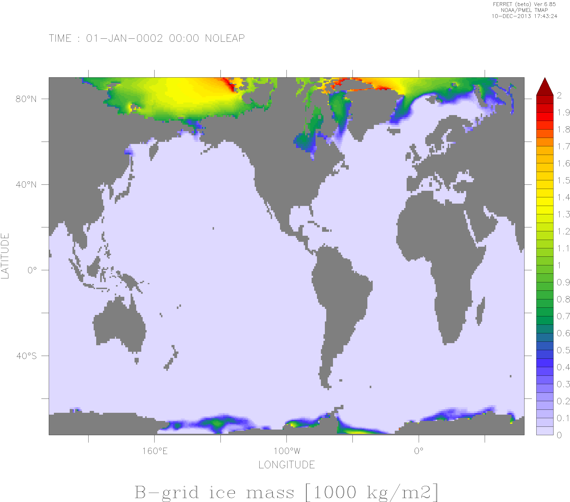
MOM/SIS history
MOM-n (n<6) staggered variables on an Arakawa B-grid
Sea Ice Simulator (SIS, now called SIS1)
Winton, 2000, thermodynamics
B-grid because of the ocean model
Used with C-grid GOLD in CM2G
Desire for single point channels in coarse resolution ocean model caused ice “pile ups”
Jan. 1, Year 2 Sea Ice Mass [1000 kg m⁻²]
“B”
“C”
Ice mass on 0002/01/01
Model space (no projection)

Slide 3
MOM6/SIS2 history
MOM6 (n=6) staggers variables using an Arakawa C-grid
With advent of MOM6, Robert Hallberg was motivated to re-develop SIS to work on C-grid
SIS2
C-grid
Winton, 2000, thermodynamics
δ-Eddington shortwave radiation (from CICE)
Access to ICEPACK
Revised thermodynamic algorithms, N snow & ice layers
Uses MOM6 infrastructure*
Fixes one aspect of single-cell wide channels
Outstanding question of geostrophic flow in single-cell wide channels
Jan. 1, Year 2 Sea Ice Mass [1000 kg m⁻²]
Delta Mass [1000 kg m⁻²]

Slide 4
Coupling (sea-)ice to MOM6
Separation of concerns
Natural for organization
Leads to independent models
FMS coupler
Essentially our main()
Invokes components (on respective processors)
Passes properties (state+fluxes) between component models via arguments
All ocean fluxes pass through sea-ice
Sea-ice skin temperature is implicit-in-time for radiation calculation
Atmosphere
state & fluxes
Land
FMS coupler
Sea ice
Icebergs
Ocean

Slide 5
Concurrent Coupling
Atmos.
Thermo
Atmos.
Dynamics
Atmos.
Thermo
Atmos. Dynamics
Atmos.
Thermo
Atmos.
Dynamics
To avoid ununsed processors, atmosphere and ocean do not wait for each other
Use/send the latest of flux/state the component has
Feedback depends on t^{n-2}
Twice as efficient as waiting!
Seems to work …
Ice
Thermo
Ice
Dynamics
Ice
Thermo
Ice
Dynamics
Ice
Thermo
Ice
Dynamics
Q(SST,T_{i},T_{a}), τ(u_{o},u_{i},u_{a})
Q(SST,T_{i},T_{a}), τ(u_{o},u_{i},u_{a})
Q(SST,T_{i},T_{a}), τ(u_{o},u_{i},u_{a})
SST, u_{o}
SST, u_{o}
SST, u_{o}
Ocean
Thermo
Ocean
Dynamics
Ocean
Thermo
Ocean
Dynamics
Ocean
Thermo
Ocean
Dynamics
Time
t^{n-1}
t^{n}
Δt_{coupled}
t^{n+1}

Slide 6
Ocean-ice instabilities of the concurrent coupled algorithm
Analysis in Hallberg, 2014:
Lagged stress instability
Inertial oscillation instability
Gravity wave instability
Thermal coupling instability
Concurrently coupled data-driven ice-ocean model
Hallberg (2014, Clivar Exchanges)

Slide 7
Concurrent/Embedded Ice Coupling
Atmos.
Thermo
Atmos.
Dynamics
Atmos.
Thermo
Atmos. Dynamics
Atmos.
Thermo
Atmos.
Dynamics
Splitting out fast sea-ice thermodynamics and moving rest of SIS2 to ocean processors
TBD: Embedding the sea-ice dynamics within the ocean
Fast rheology solver to be part of ocean barotropic solver
Ice Fast
Thermo†
Ice
Dynamics
Ice Fast
Thermo†
Ice
Dynamics
Ice Fast
Thermo†
Ice
Dynamics
Q(SST,T_{i},T_{a}), τ(u_{o},u_{i},u_{a})
Q(SST,T_{i},T_{a}), τ(u_{o},u_{i},u_{a})
Q(SST,T_{i},T_{a}), τ(u_{o},u_{i},u_{a})
SST, u_{o}, ice state
SST, u_{o}, ice state
SST, u_{o}, ice state
Ice Fast
Thermo
Ice Fast
Thermo
Ice Fast
Thermo
Ice
Dynamics
Ice Slow
Thermo
Ice
Dynamics
Ice Slow
Thermo
Ice
Dynamics
Ice Slow
Thermo
Ocean
Thermo
Ocean
Dynamics
Ocean
Thermo
Ocean
Dynamics
Ocean
Thermo
Ocean
Dynamics
Time
Δt_{coupled}

Slide 8
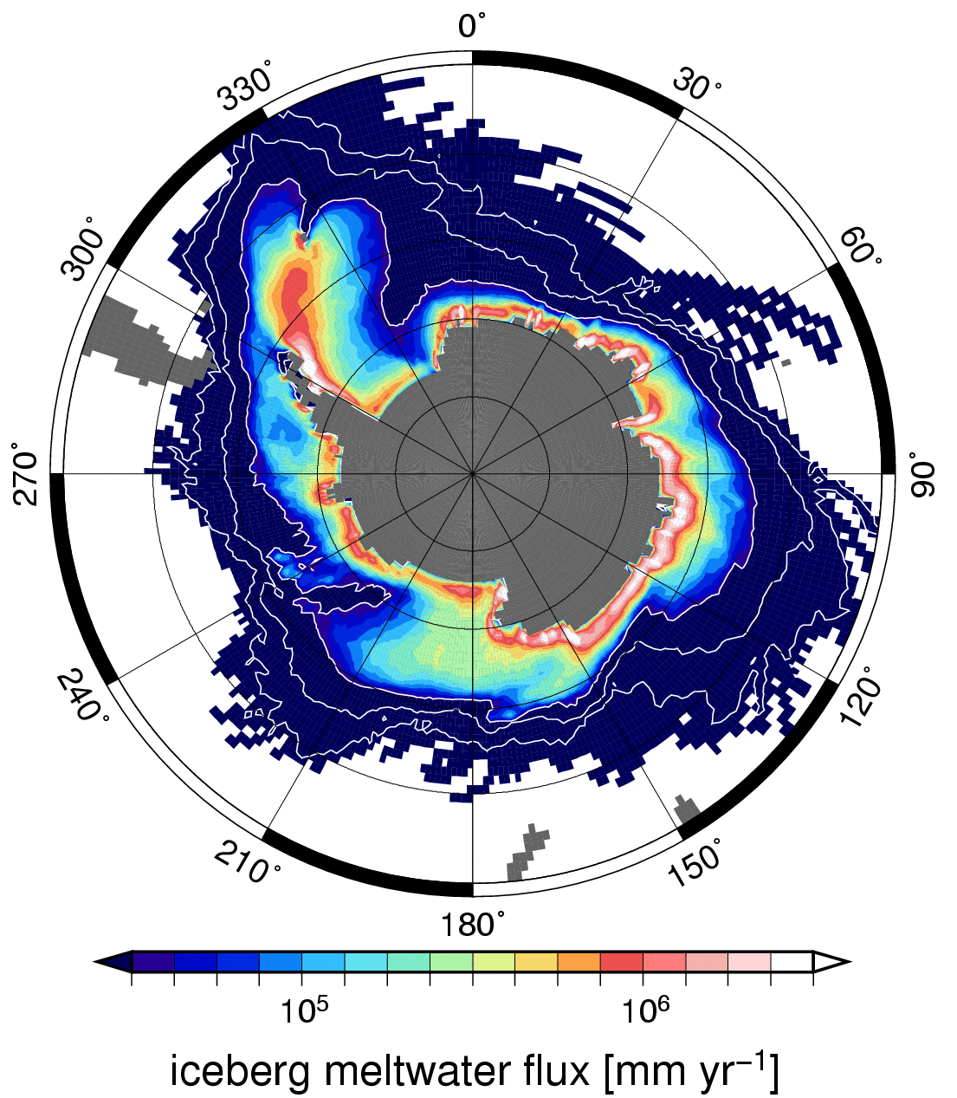
Particle Icebergs
Particle iceberg model transports ice from continent out to open ocean to melt
Addresses cold-fresh bias around Antarctica (led to excess sea-ice)
Iceberg positions with 10 day trails
Bigg et al. (1997), Gladstone et al. (2001), Jongma (2009), Martin et al. (2010), Marsh et al., (2015), Stern et al. (2016)
Notes:
The new iceberg model/component follows the published model of Gladstone, Bigg and others
To make it feasible for climate purposes we have made various innovations (e.g. instead of just 1000 bergs spread over a year, we allow of order 100,000’s instantaneously).
In the upper right, we see a one year animation of icebergs with 10 day trails overlaying monthly SSTs.
Note that there is significant seasonality and variability in the iceberg evolution.
Iceberg evolution is very much a function of the instantaneous winds and currents and so can sometimes be coherent (patterns/seasonal) and sometimes quite sporadic.
In the bottom left I’m showing the change in ideal age of the water sitting on the bottom resulting from incorporating icebergs into the model.
The net effect of moving the cold and fresh water source for the ocean from the coastal shelves away to open water is to increasing ocean ventilation and deep water formation, particularly on the shelves.
In Torge Martin’s poster, you will be able to see more clearly that this arises mostly from an increase of shelf water formation.
8

Slide 9
Iceberg improvements: 1. finite size
Point particles moving from cell to cell trigger gravity waves in underlying ocean
Led to icebergs surfing on their own wake!
Early workarounds:
Levitate icebergs
Smooth out weight on ocean
Impose speed limits!
Give particles finite size and distribute weight properly
Iceberg depresses ocean
Iceberg
Ocean columns
Ocean response to removing weight of iceberg

Slide 10
Iceberg improvements: 2. interactions
Point particles never intersect
Finite size can intersect so we added “collisions” with spring dynamics
Springs allow smoother evolution and allows moderate time-step
Solves piling up of excessive mass in each ocean cell
However, elements still should be smaller than ocean grid cell
Unlimited mass in cell
Finite mass in cell
Infinitesimal points
Cylindrical icebergs
Ocean resolves shape of single element
- multi-cell calculations

Slide 11
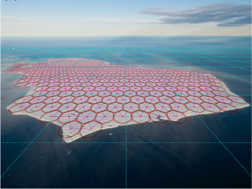
Iceberg improvements: 3. bonds
Allowing springs to not just repel but “bond” particles together allows “tabular ocebergs” larger than grid cell
“KID”
Stern et al. (2017)

Slide 12
Idealized iceberg calving and breaking
“KID”
Ice-shelf
Plan view of sea-surface temperature (°C) and ice thickness
White-grey indicates ice thickness
Vertical section across cavity/through iceberg showing ocean temperature and displacement by ice
Ice-shelf cavity
(extends to the left)
Colors indicate ocean temperature (°C)
Stern et al. (2017)

Slide 13
Ice shelf cavities
MOM6 LRM (ALE) algorithm enables wetting and drying
Ice shelf cavities simulated with evolving iceshelf model coupled to ocean
Moving upper boundary
Moving grounding line
Ocean is squashed between shelf and bedrock
Used in ⅛° coupled ocean-ice-shelf global simulations
Ice shelf
Bedrock
Courtesy of Gustavo Marques, circa 2017

Slide 14
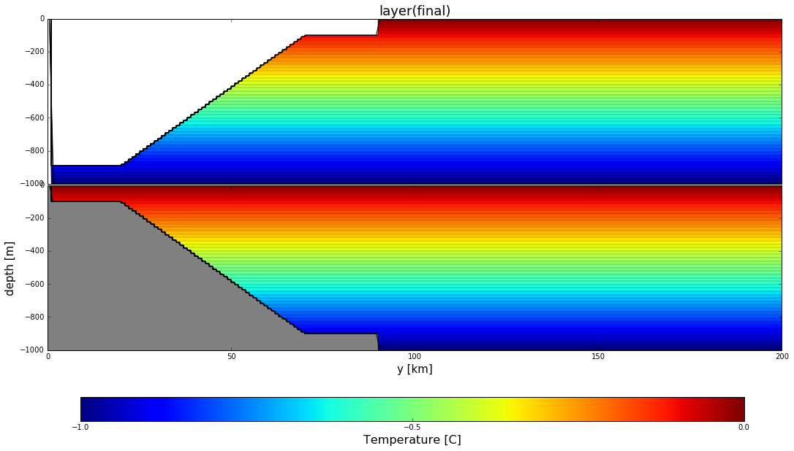
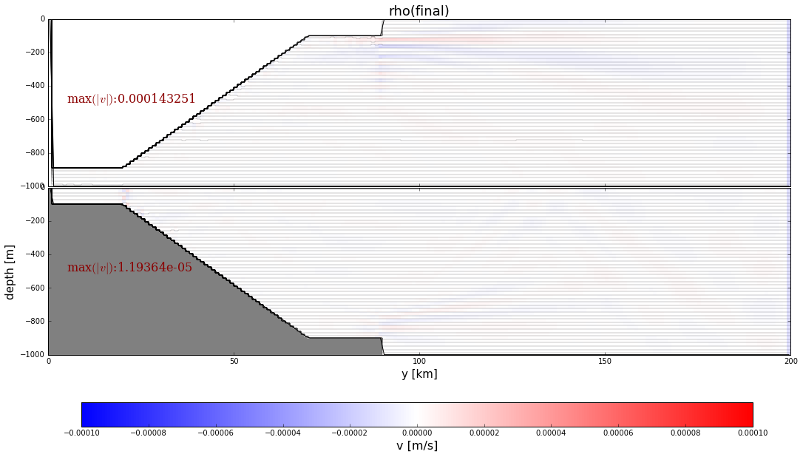
Ice shelf edges
Idealized configurations to sort out the (annoyingly hard) details
Gustavo Marques and Matt Harrison

Slide 15
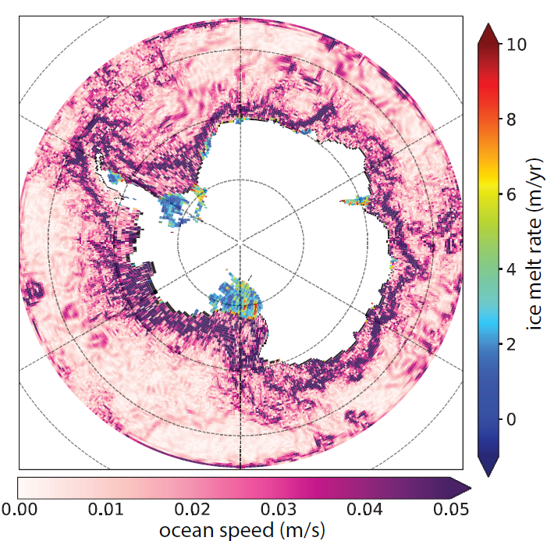
Where we are now
Challenges using different coordinates with iceshelf cavities
Recently found one archaic “feature” that explains a long standing problem under shelf
Currently have a dynamic ice-shelf solver within MOM6
Three-equation model for melt fluxes
Targeting NOAA sea-level mission
Initialized with present-day observation
Parameters optimized during preprocessing
Sergienko; Harrison

Slide 16
KID to iKID
KID-era we were trying to use approximate dynamics
Smooth Particle Dynamics
No rotational moments
Simple interactions (springs in line with centers of mass) for “bonds”
It “worked” but wasn’t complete enough for glaciology
Added rotational degrees of freedom
Element interactions account for horizontal bending moments and shear forces
Stress criteria for bond breaking
MTS velocity Verlet to make model affordable (fast adjustments between elements)
Stern, Adcroft, Sergienko & Marques, 2017
Huth, Adcroft, Sergienko & Khan, Sci. Adv., 2022

Slide 17
Modelling a break up event (A68a)
“iKID”
We used the observed breakup of A68a to test a the new giant tabular iceberg model
Two break up events triggered by
collision with ocean bottom
shear of ocean currents
new process!
Dec 17, 2020, A68a was 50km from South Georgia
Huth, Adcroft, Sergienko & Khan, Sci. Adv., 2022

Slide 18
Foundations for floe-resolving sea-ice model
Continuum sea-ice models
Typically on same grid as ocean model
Rheology inappropriate at floe scales
Lagrangian sea-ice models
Can represent floes directly
Statistic representations
Implicitly finer resolution
Currently investigating approximate dynamics
A test of “jamming” in a strait using reduced dynamics
Damsgaard et al., 2018

Slide 19
Future plans with ice
Up next:
Embedding of SIS2 into MOM6*
Embedding if iKID into MOM6*
Currently KID is called by SIS2
iKID is stand alone
Coupling to contemporary ice sheet / shelf model
Collaborating with NCAR
Figure out how to calve icebergs from ice shelves!
Much longer term:
Consider Lagrangian approach for sea-ice
Might be necessary for the marginal ice zone
Unified Lagrangian treatment of all ice in contact with the ocean
Consider Lagrangian approach for all ice
*Software challenges

