Slide 1
Decadal Climate Forecasting Project
1
Project leader: Richard Matear
3 Activities:
Data Assimilation, Climate Modelling and Ensemble Generation (Leader: Terry O’Kane)
Processes and Observations (Leader: Bernadette Sloyan)
Verification and Application (Leader: James Risbey)
– initially focused on multi-year time-scale where we have sufficient data to assess forecast skill

Slide 2
2
New Team Members:
Vassili Kitsio (Activity 1), Thomas Moore (2), Dougie Squire (3)
Paul Sandery (1), Chris Chapman (2)

Slide 3
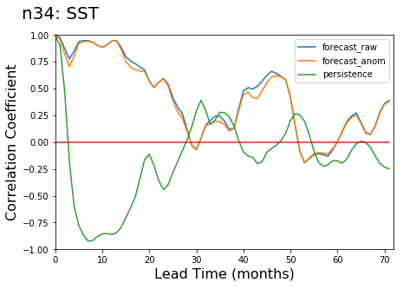
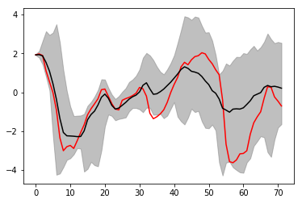
Potential Predictability: NINO3.4
3
15 January forecasts
Example Forecast

Slide 4
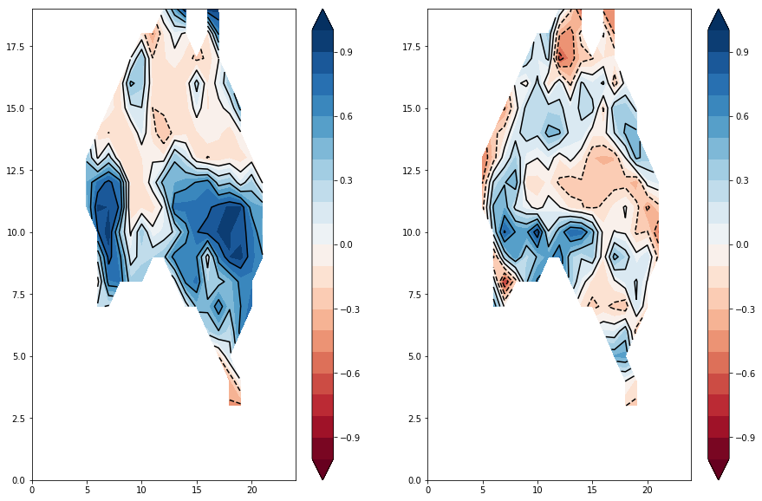
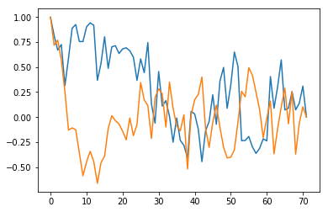
Potential Predictability: Soil Moisture
4
20-month lead: Correlation Coefficient
South Australia: (south of 33°S)
Anomaly Correlation Coefficient
Blue- forecast
Orange - persistence
forecasts
Persistence
15 January forecasts
Lead Time (months)

Slide 5
5
5
Forecast Dataset - 2002 -2016
Climate state estimated using EnOI
Ensemble generation with Bred Vectors
V0 – everywhere between 20S and 20N
V1 – subsurface ocean region of high variance (20S – 20N)
Forecast
every month of length 2 years with 11 ensemble members
every 6 months of length 6 years with 11 ensemble members

Slide 6
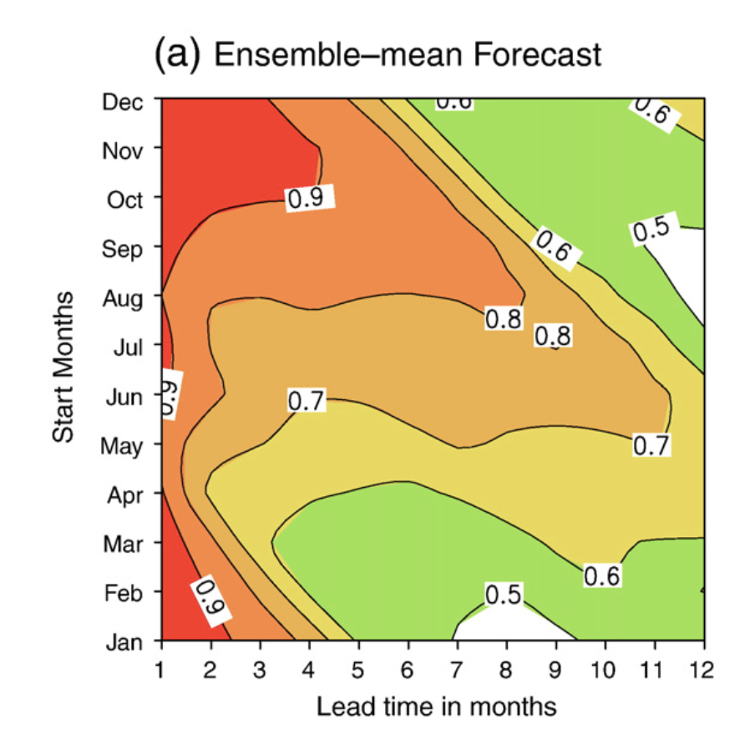
ENSO – Anomaly Correlation
6
v0
Zheng 2010
v1

Slide 7
Nino4 Discrimination Plot:
7
v0
v1
Assess the ability to forecast an event (El Nino or La Nina) and no event
Not able to reliably forecast
an event
3 months
6 months
9 months

Slide 8
Nino4 Discrimination Plot:
8
v1
v1
Not enough events
In the forecast
3 months
6 months
9 months

Slide 9
9
9
CAFE System
Climate Model – MOM5 (SISE,WOMBAT) with AM2 ->
MOM5 with AM3 and ACCESS-ESM 1
Data Assimilation – EnOI with ocean observations ->
EnKF (96 members) with ocean, sea ice and atmospheric data
Ensemble generation with Bred Vectors ->
several different sets of BVs targeting different time-scales
Forecasts – new dataset of monthly forecasts to follow the couple DA development (6 months)

Slide 10
10
Post Doctorial Positions
https://jobs.csiro.au
Postdoctoral Fellowship Sea Ice Modeller (56719)
Postdoctoral Fellowship - Climate regimes (56508)
Postdoctoral Fellowship - Ocean-Atmosphere dynamics (56622)
CSIRO Postdoctoral Fellowship – Atmospheric Dynamics
CSIRO Postdoctoral Fellowship - Ocean-Atmosphere Carbon Fluxes (49441)

Slide 11
ROC:
11
v0
v1
4 months
6 months
9 months

Slide 12
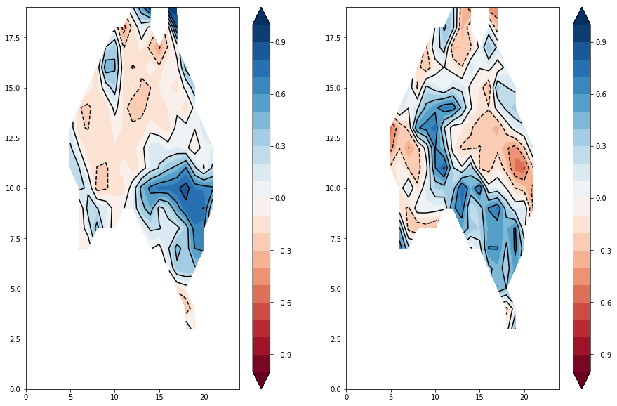
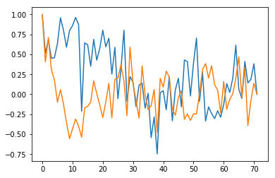
Potential Predictability: Rainfall
12
20-month lead: Correlation Coefficient
South Australia (south of 33°S):
Anomaly Correlation Coefficient
Blue- forecast
Orange - persistence
forecasts
Persistence
15 January forecasts
Lead Time (months)

Slide 13
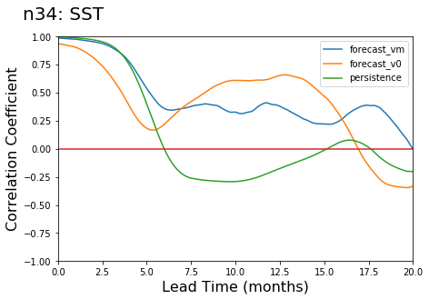
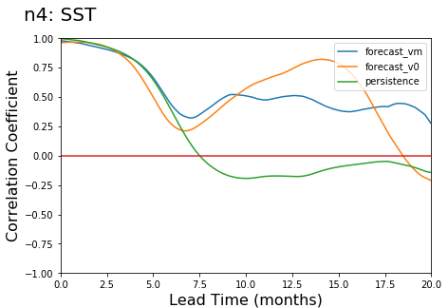
Forecasts: DA vs Reanalysis – for initial state
13
January forecasts (2005 to 2016)

Slide 14
Decadal Climate Forecasting Project
14
Initial Goals
  Build the Climate Analysis Forecast Ensemble (CAFE) system and deliver multi-year to decadal climate forecasts (probabilistic problem and we will provide ensemble forecasts)
  Apply diagnostics tools, including ensemble verification metrics, to accurately assess the skill of the forecasts
  Advance fundamental research into: where does the predictability of the climate system resides, the processes that give rise to that predictability, and the key observations that help us to realise the potential climate predictability
  Explore the utility of our climate forecasts for a select group of external clients (e.g. Digiscape)

Slide 15
Data Assimilation, Climate Modelling and Ensemble Generation
15
Develop and run a coupled ocean-atmosphere-sea ice climate model
data assimilation scheme to incorporate observations into the climate model to characterise the climate state
Ensemble climate forecasting system initiated from the climate state
This is the core of the Climate Analysis Forecast Ensemble (CAFE) system

Slide 16
Processes and Observations
16
Climate Processes that drive potential predictability
Predictability Studies
Observing System Experiments and Observing System Simulation Experiments
New observation for data assimilation (e.g. sea ice, ocean colour) and assessment of their impact on the climate forecasts

Slide 17
Application and Verification
17
• need process-based skill assessment
• understand mechanisms underlying forecasts
• outline deficient process representations in model
• provide narrative for forecast use
• document skill in public archives and over time
• no magic
Strong overlap with all components of CAFE System

Slide 18
Forecast Dataset - 2002 -2016
every month of length 2 years with 11 ensemble members
every 6 months of length 6 years with 11 ensemble members
To apply a forecast
need to understand what the forecast is
need to know how to use it
need to evaluate how good it is
need to understand its limitations
need to support the close collaboration between the generation of the forecast and the users
18

