Slide 1
Maintenance of the zonal momentum balance of the Antarctic Circumpolar
Current (ACC) by barotropic dynamics
Xihan Zhang
Supervisory team: Maxim Nikurashin, Beatriz Pena Molino, Stephen Rintoul, Edward Doddridge

Slide 2
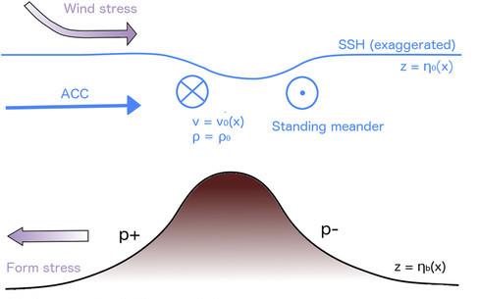
Background: momentum balance between wind stress and TFS
Depth-integrated momentum balance of the Antarctic Circumpolar Current (ACC) is between wind stress and topographic form stress (TFS) (e.g., Munk & Palm 1950)
Topographic form stress arises from pressure difference across topography
This depth-integrated balance suggests that momentum is ‘transmitted’ from the surface to the bottom throughout the water column (e.g., Johnson and Bryden, 1989)
TFS
Stewart and Hogg 2017

Slide 3
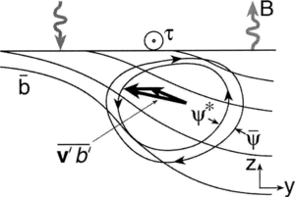
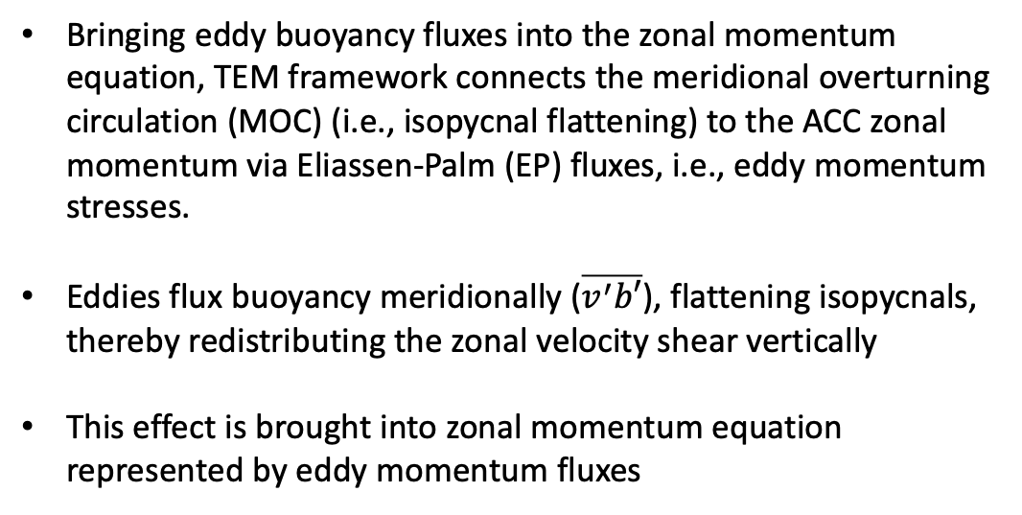
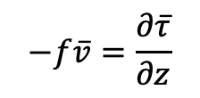
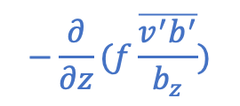
Background: Eddies transfer momentum downwards (TEM framework)
Bringing eddy buoyancy fluxes into the zonal momentum equation, TEM framework connects the meridional overturning circulation (MOC) (i.e., isopycnal flattening) to the ACC zonal momentum via Eliassen-Palm (EP) fluxes, i.e., eddy momentum stresses.
Eddies flux buoyancy meridionally ($\overline{v^{′}b′}$), flattening isopycnals, thereby redistributing the zonal velocity shear vertically
This effect is brought into zonal momentum equation represented by eddy momentum fluxes
Meridional isopycnal structure
$$v^{∗}=\frac{∂}{∂z}(\frac{\overline{v^{′}b′}}{b_{z}})$$
Marshall and Radko 2003
eddy momentum stress
$$−f\overline{v}=\frac{∂\overline{τ}}{∂z}$$
$$−\frac{∂}{∂z}(f\frac{\overline{v^{′}b^{′}}}{b_{z}})$$
wind stress matches to eddy momentum stress in the limit of zero residual circulation
$$−fv^{∗}$$
$$−fv^{∗}$$
$$fv_{res}$$

Slide 4
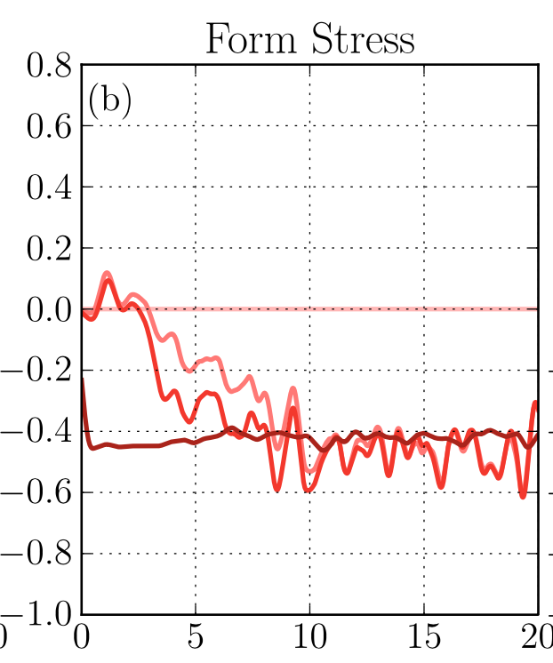
Background: Barotropic vs baroclinic dynamics for the ACC momentum balance
TEM and isopycnal frameworks naturally put emphasis on baroclinic structure/eddy fluxes for the maintenance of the ACC momentum balance
Howard et al (2015) shows that TFS is quickly established through barotropic dynamics during the initial transient phase, but then they argue that eddies are responsible for the momentum transfer at equilibrium
In this study, we explore the maintenance and adjustment of the ACC momentum balance from a Eulerian, depth-coordinate perspective
We show that the ACC momentum balance is not only initially established, but also maintained at equilibrium and responds to changes in wind by barotropic dynamics
Eddy momentum stress
TFS
Year
Howard et al (2015)

Slide 5
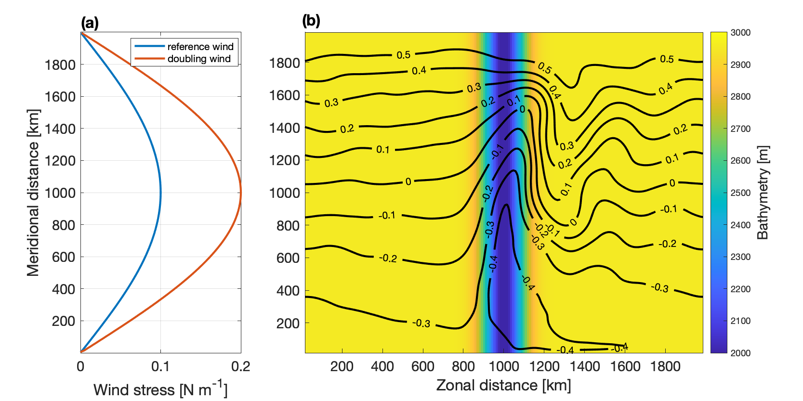
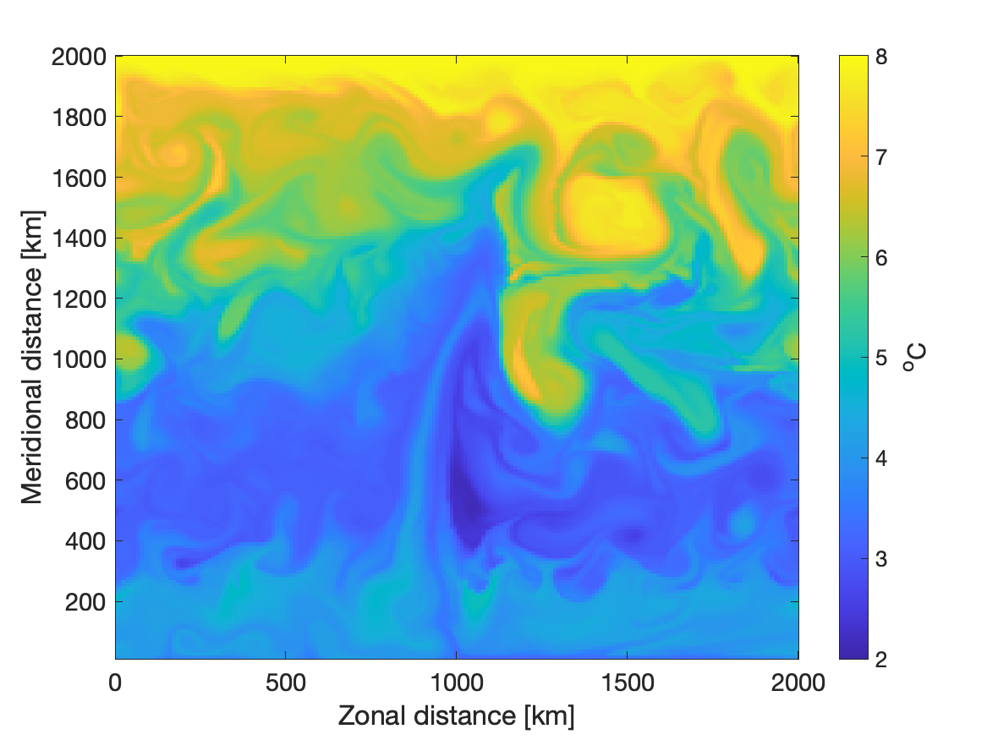
Method: an idealized channel model with a ridge
MITgcm
Zonally re-entrant channel, depth-coordinate model
A Gaussian ridge in the middle of the domain
10-km horizontal resolution
Stratified (barotropic/baroclinic) & homogenous (only barotropic) simulations
Model bathymetry and mean SSH
A snapshot of surface temperature

Slide 6
Mechanism: Spin up from rest
Surface Ekman layer piles water in the north, which drives a zonal flow through barotropic dynamics (SSH slope)
Zonal flow interacts with a ridge and sets TFS. Return flow, balanced by TFS, closes the total volume budget (i.e., equilibrates SSH)
Upwelling and downwelling formed from continuity steepen isopycnals in a stratified flow
Steepening isopycnals generate baroclinic pressure gradient that opposes barotropic pressure gradient due to SSH slope
Thus, SSH keeps tilting to maintain the TFS and compensate for the isopycnal steepening
z
L
H
SSH stops tilting when baroclinic eddies appear and act to flatten the isopycnals (i.e., baroclinic structure reaches equilibrium and mass budget is closed)
L
H
L
H
y
Momentum balances (wind stress = Coriolis at the surface and Coriolis = TFS at the bottom) are closed without momentum stresses (i.e.., transfer) in the interior
Red: barotropic dynamics
Blue: baroclinic dynamics

Slide 7
Mechanism: Response to changes in wind
When wind stress increases, baroclinic structure is saturated, and it is the barotropic dynamics that respond and adjust the system to a new equilibrium:
Increased wind stress drives a stronger northward flow in the surface Ekman layer
SSH slopes more significantly and generates a stronger barotropic pressure gradient
z
L
H
The stronger barotropic pressure increases the bottom flow, resulting in stronger TFS (and return flow) that balances the increased wind (Ekman transport)
L
H
L
H
y
Red: barotropic dynamics
Blue: baroclinic dynamics

Slide 8
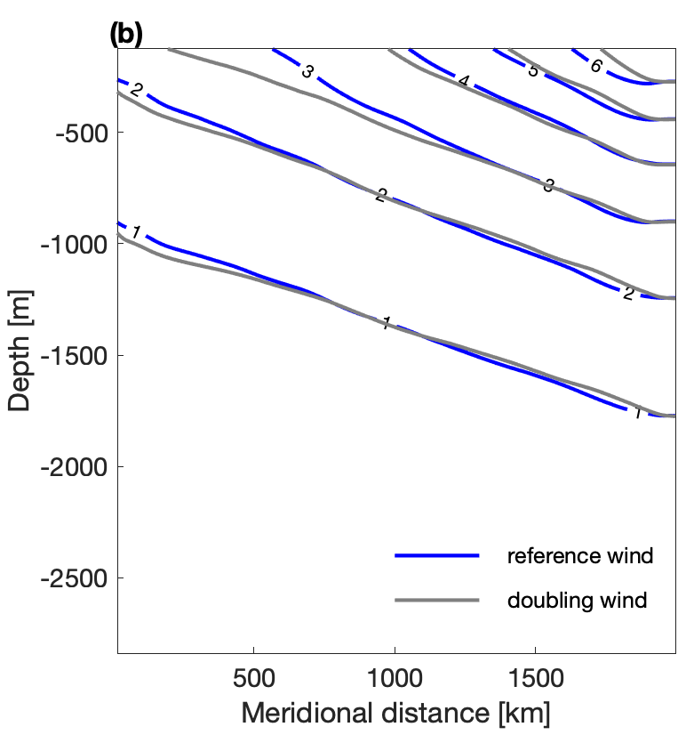
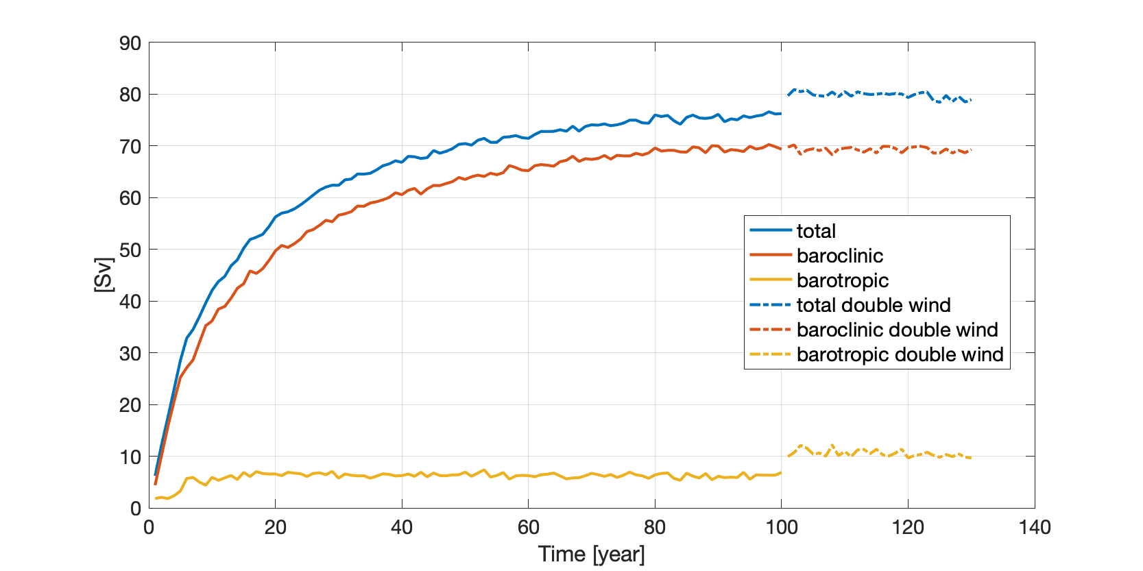
Results: Response to wind – saturated baroclinicity
Baroclinic dynamics is saturated
Isopycnal slopes & Baroclinic transport have no adjustment to wind
It is the barotropic transport that changes and account for the increase in the total transport
Wind doubled

Slide 9
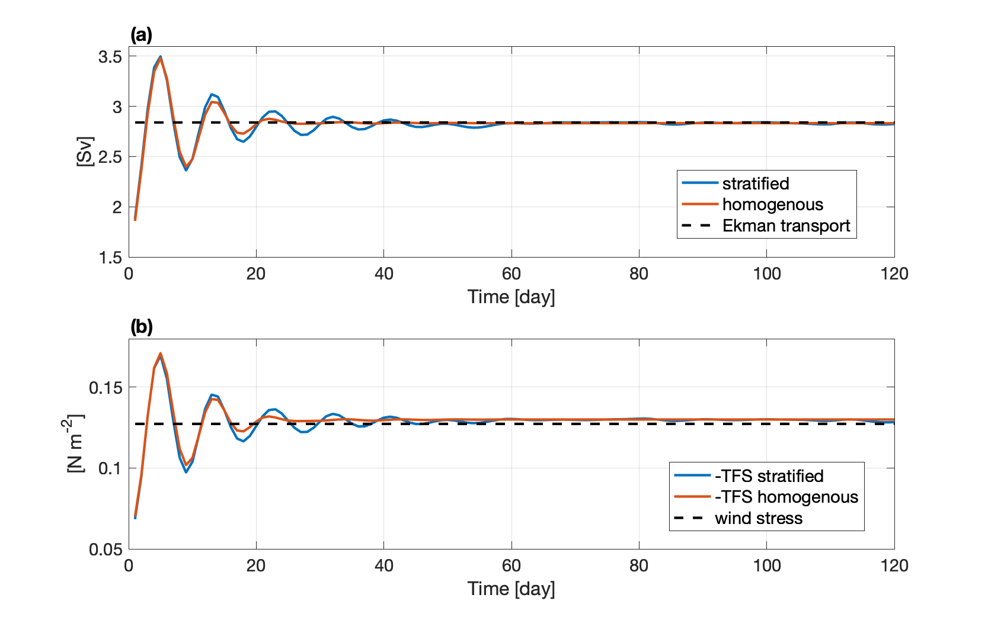
Results: Response to wind – adjustment by barotropic dynamics
Wind doubled
Depth-integrated momentum balance is readjusted to a new balance within the first month after doubling of the wind
Return flow at the bottom shows the same adjustment as during the spin-up stage, which is related to the establishment of TFS
Stratified simulation and homogenous simulation undergo a similar adjustment in response to changes in wind, suggesting that baroclinic eddies are not essential for the wind-TFS balance
Adjustment of the return flow to Ekman
Adjustment of TFS to wind stress

Slide 10
Summary
We explore the maintenance of the ACC zonal momentum balance from a Eulerian, depth-coordinate perspective. While it is mathematically equivalent to TEM (or, isopycnal framework), it offers a different and useful insight in the governing dynamics
In this framework, eddy fluxes are part of the buoyancy budget and momentum balances at the surface and bottom are connected by flow continuity and regulated by pressure fields without momentum stresses in the interior.
It is the barotropic dynamics that maintains the depth-integrated momentum balance between wind stress and TFS, compensating also for the opposing effect of baroclinicity
The critical role of the barotropic dynamics in this balance explains the short time-scale of the ACC (TFS, total transport, eddy fluxes) adjustment to wind

