Slide 1
Are Climate Models Biased by Zooplankton Grazing?
Tyler Rohr
IMAS – Lecturer in SO Biogeochemical Modelling
Co-authors: Anthony Richardson, Andrew Lenton, Elizabeth Shadwick, Matt Chamberlin
Notes:
Hi everyone, I’m Tyler, a postdoc down in Hobart, and I’ll give you a quick schpeel on the sensitivity of Southern Ocean carbon cycling to grazing rates in a global marine biogeocheical model.

Slide 2
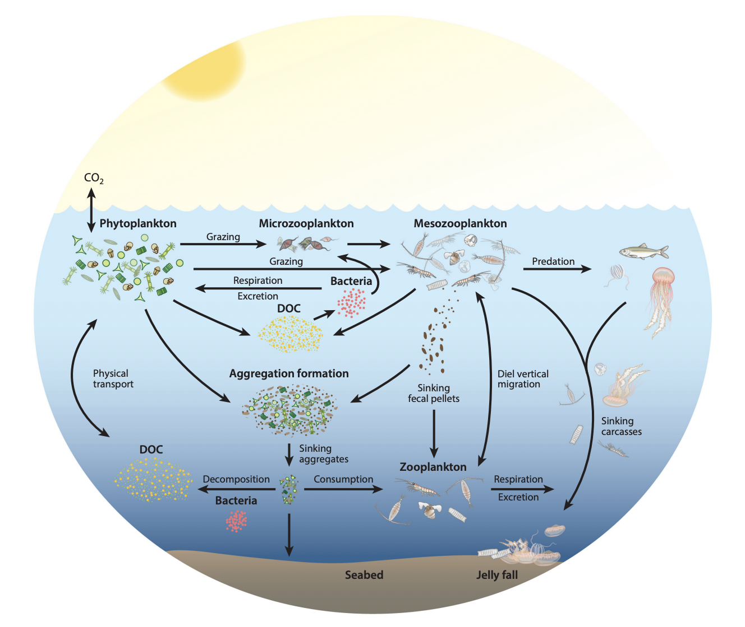
Grazing and the Marine Carbon Cycle
Grazing dominates phytoplankton loss rates and the size of the biomass pool, indirectly regulating net primary production (NPP).
NPP
The carbon lost to grazing is transferred to higher trophic levels directly regulating gross secondary production (GSP).
GSP
This changes the way POC is distributed and transferred to depth via active and passive transport as export production (EP).
EP
Source: Steinberg & Landry (2017)
Notes:
So first some really quick background
Grazing by zooplankton dominates phytoplankton loss rates and thus the amount of phytoplankton available for NPP.
That carbon is then routed into gross secondary production, which fuels higher trophic levels.
And Export Production is in turn modified by both the size of NPP as well as the distribution of POC in the phytoplankton and zooplankton pools.

Slide 3


The Functional Response for Grazing
$$g_{max}$$
$$K_{1/2}$$
Notes:
So what do we known about how grazing rates and how they vary.
Well, zooplankton are food limited at low phytoplankton concentrations but eventually become satiated at high ones.
This mean that we need two parameters to describe grazing:
Gmax, which describes the rate of grazing at saturation
And K, which describes how much prey is needed to get there,

Slide 4
Grazing Parameters - Empirical Estimates
$$g_{max}$$
$$K_{1/2}$$
Notes:
So what do we known about how grazing rates and how they vary.
Well, zooplankton are food limited at low phytoplankton concentrations but eventually become satiated at high ones.
This mean that we need two parameters to describe grazing:
Gmax, which describes the rate of grazing at saturation
And K, which describes how much prey is needed to get there,

Slide 5
Grazing Parameters - Empirical Estimates
Empirical Estimates (solid) : Nanoflag. Dinoflag. Cilitates Rotifers Mero. Larvae Copeods Cladocerans
Notes:
And what are the values of these parameters?
Well its really hard to measure them in-situ, but there have been a lot of laboratory dilution experiments, some of which I’ve plotted here on log-log scale.
The problem is, they span nearly 4 orders of magnitude and vary with species, size, and age.

Slide 6
Grazing Parameters – Used in Models
Empirical Estimates (solid) : Nanoflag. Dinoflag. Cilitates Rotifers Mero. Larvae Copeods Cladocerans
Used in Models (unfilled) : Microzooplankton Mesozooplankton Macrozooplantkon
Unclassified
Notes:
unsurprisingly, the values that get used in models, overlaid now in red, are also all of over the place.
Now despite this uncertainty, I couldn’t find any global sensitivity analysis testing anywhere near a
large enough range of grazing parameters.

Slide 7



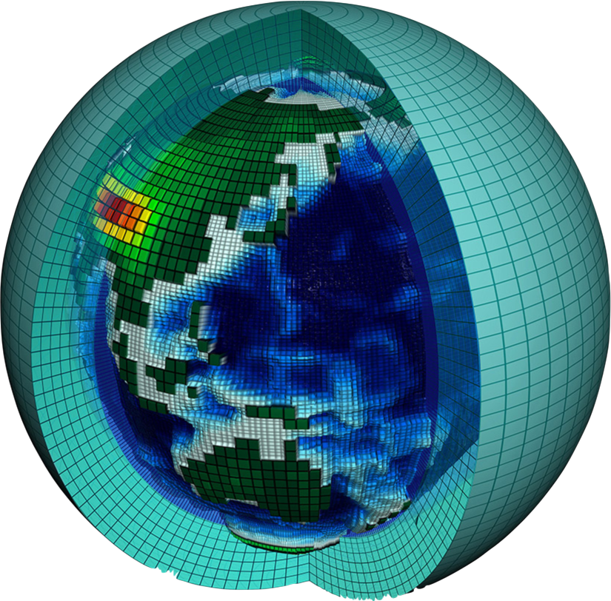





Cobalt v2
WOMBAT
BFM5.2
CMOC
CMIP6 Simulated Food Webs
PISCESv2
100x
HAMOCCv2
MEDUSA2.1
OECO-v2
Z
Zooplankton
CanOE
MARBL
Phytoplankton
Bacteria/POC
Notes:
A) In the outer circle a schematic 10 CMIP6 BGC planktonic food webs is shown. Outside each schematic the name of the model, the country of development, and the number of parameters in the grazing formulation are noted.
* Add Flags to stree international bit?
Show Range
Get Text box angle consistent with mean of bounding line
-Same with Schematics

Slide 8
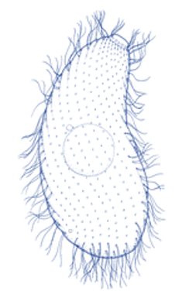
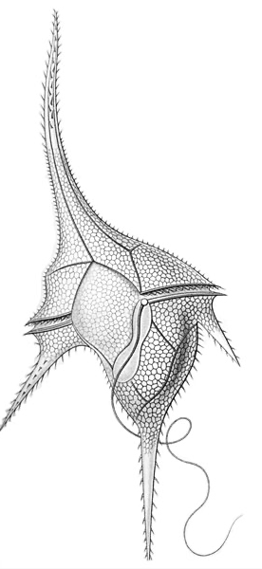
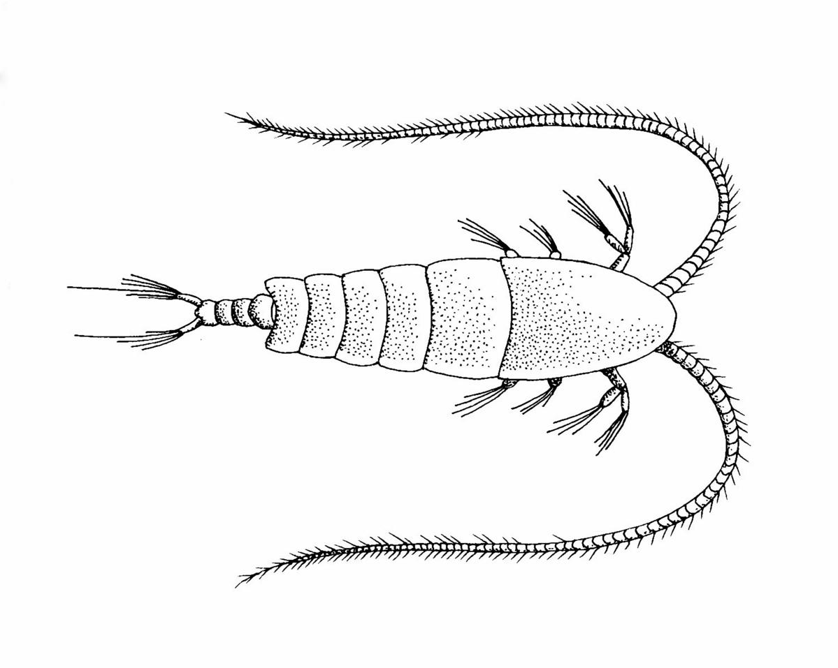
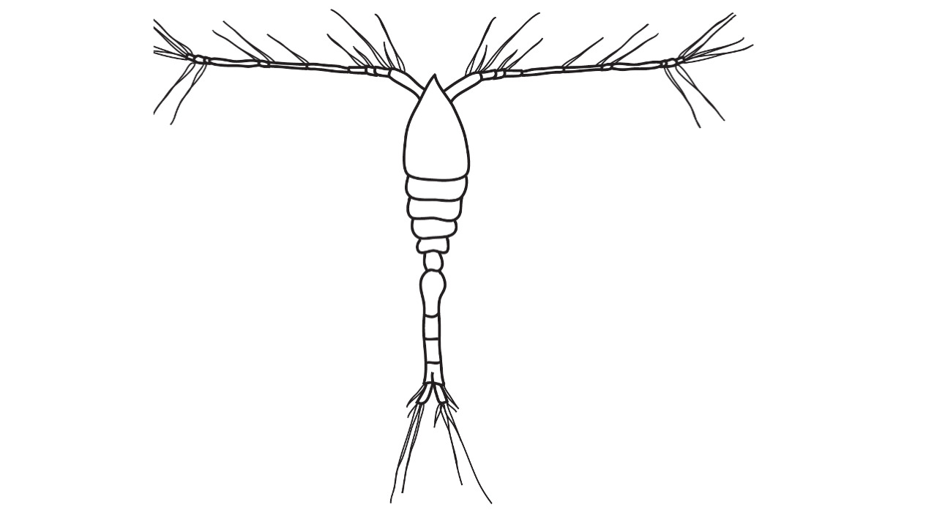
Trait Based Groups
Empirical Estimates (solid) :
Microzooplankton
Mesozooplankton
g_{max} (d⁻¹)
K_{1/2} (mmol m⁻³)
Notes:
unsurprisingly, the values that get used in models, overlaid now in red, are also all of over the place.
Now despite this uncertainty, I couldn’t find any global sensitivity analysis testing anywhere near a
large enough range of grazing parameters.

Slide 9
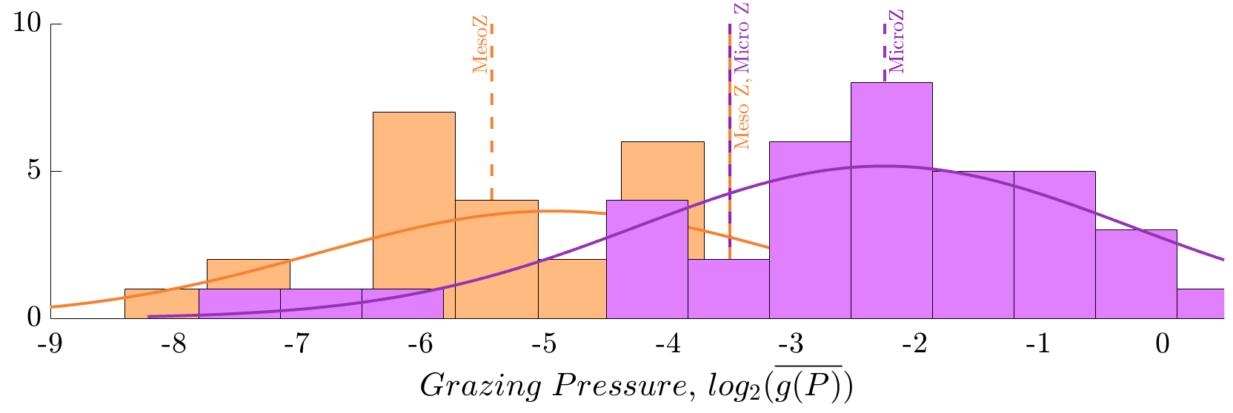
Mesozooplankton
~15x
Microzooplankton
Crustaceans
Microzooplankton
Frequency of Measured
Grazing Pressure
Notes:
unsurprisingly, the values that get used in models, overlaid now in red, are also all of over the place.
Now despite this uncertainty, I couldn’t find any global sensitivity analysis testing anywhere near a
large enough range of grazing parameters.

Slide 10
Cobalt v2
WOMBAT
BFM5.2
CMOC
CMIP6 Simulated Food Webs
PISCESv2
100x
HAMOCCv2
MEDUSA2.1
OECO-v2
Zooplankton
CanOE
MARBL
Phytoplankton
Bacteria/POC
Notes:
A) In the outer circle a schematic 10 CMIP6 BGC planktonic food webs is shown. Outside each schematic the name of the model, the country of development, and the number of parameters in the grazing formulation are noted.
* Add Flags to stree international bit?
Show Range
Get Text box angle consistent with mean of bounding line
-Same with Schematics

Slide 11

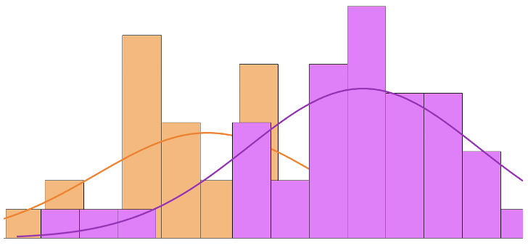
Cobalt v2
WOMBAT
Meso- Zooplankton
Micro-
Zooplankton
BFM5.2
CMOC
CMIP6 Mean Grazing Pressure
PISCESv2
Observations
72x
HAMOCCv2
OECO
MARBL
MEDUSA
CMOC
WOMBAT
Micro. Zoo.
Meso. Zoo.
BFM
CanOE
HAMOCC
Meso. Zoo &
Micro. Zoo.
MEDUSA2.1
Cobalt,
PISCESv2
OECO-v2
Z
Zooplankton
CanOE
MARBL
Phytoplankton
POC/Bacteria
Notes:
A) In the outer circle a schematic 10 CMIP6 BGC planktonic food webs is shown. Outside each schematic the name of the model, the country of development, and the number of parameters in the grazing formulation are noted.
* Add Flags to stree international bit?
Show Range
Get Text box angle consistent with mean of bounding line
-Same with Schematics

Slide 12
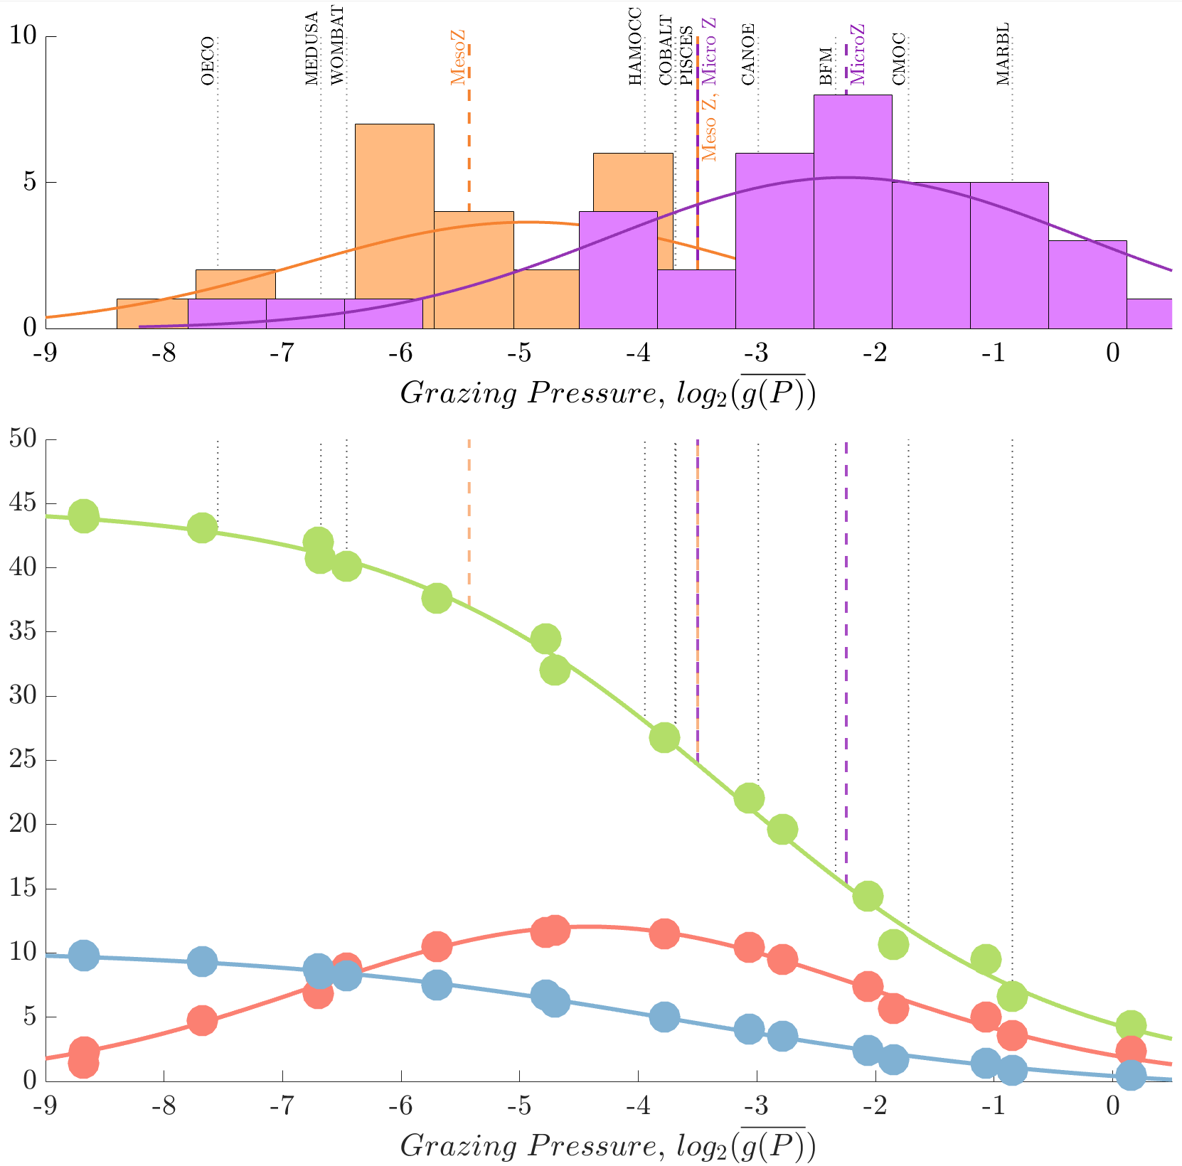
A
Mesozooplankton
Microzooplankton
Frequency of Measured
Grazing Pressure
B
Simulated
Productivity (PgC yr⁻¹)
NPP ;GSP; EP

Slide 13
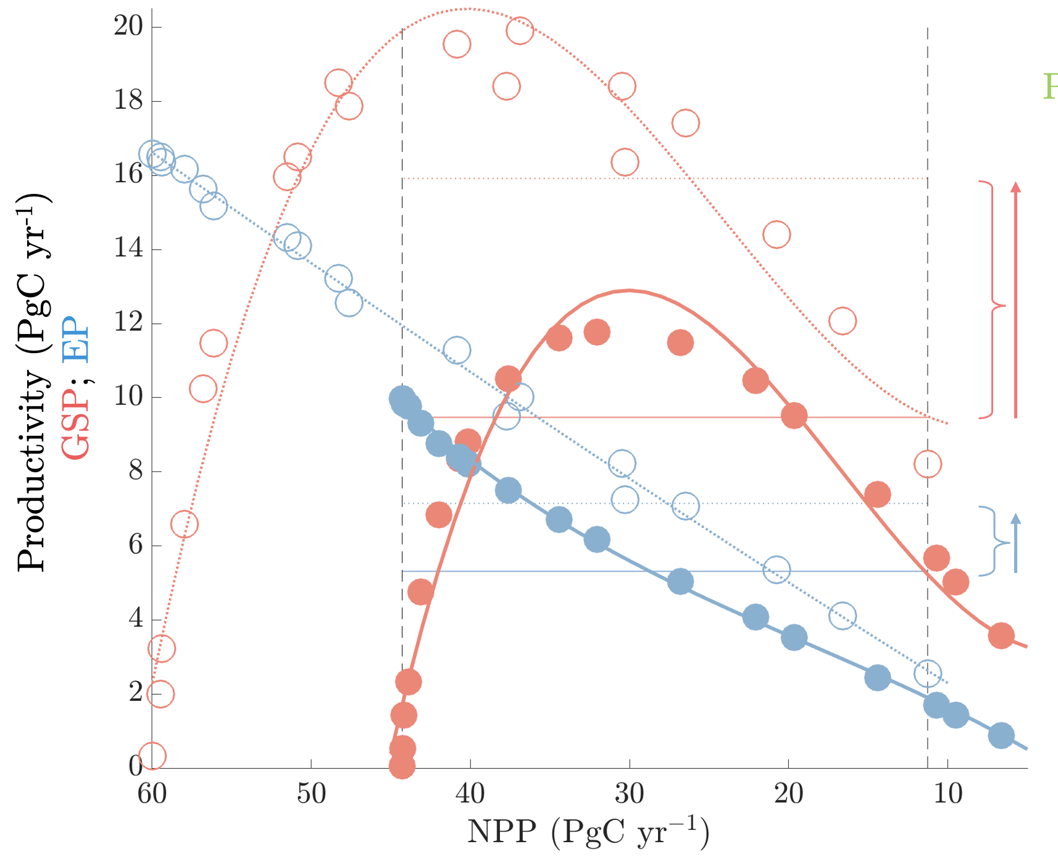
Over-tuned and Under-constrained
Increasing Grazing Pressure by ~3x yields identical NPP, but:
GSP increases by
~5 PgC yr⁻¹ (42%)
And EP increases by
~2 PgC yr⁻¹ (35%)
There is a nearly a 100 fold difference in grazing pressure prescribed in models
Ctrl Rates
(ACCESS - WOMBAT)
~3x Faster
(CESM2 - MARBL)
Notes:
So, for example, in two ensembles tuned to the same net primary production, I found a 2 Pg/yr difference in how much of that carbon got sequestered. That’s double the most optimistic estimates of Southern Ocean Iron Fertilization, and more concerningly the difference in grazing pressure prescribed in those two ensembles, was less than 5% of the full range prescribed in contemporary IPCC models.
This all goes to say, there could be a huge bias in predictions of the biological pump based on how we assume zooplankton are grazing.

Slide 14
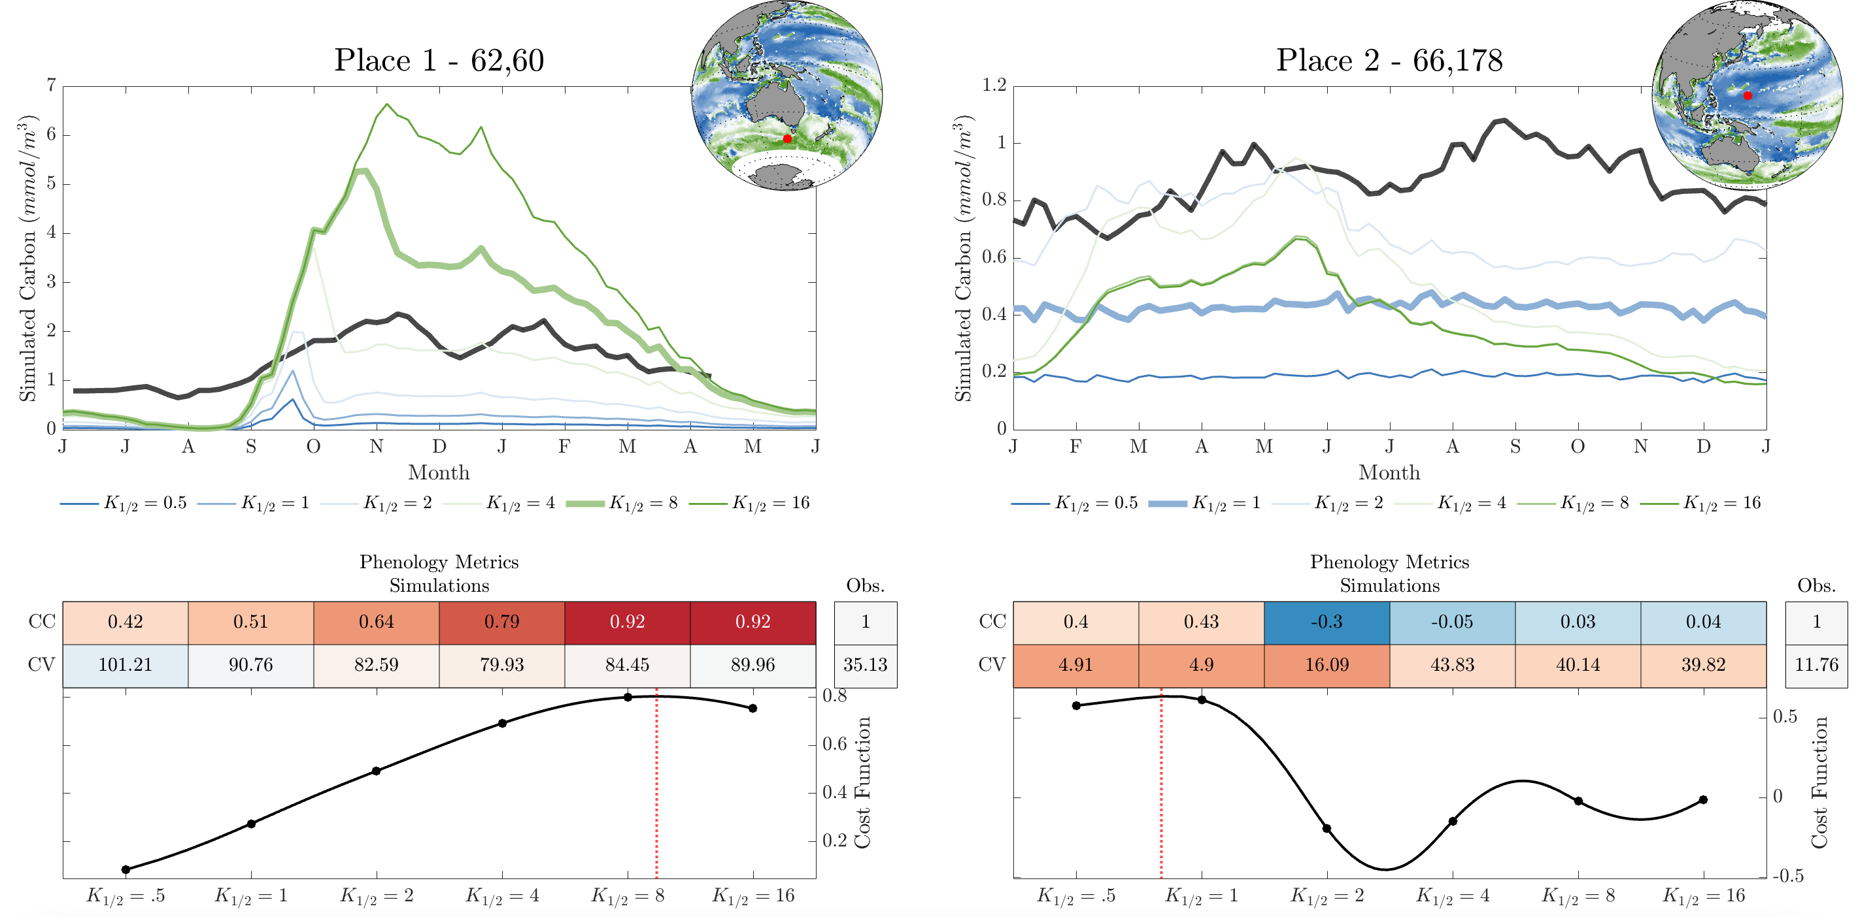
What’s the right grazing pressure?
Notes:
Could do type II next to type III?
Or just one globa?

Slide 15
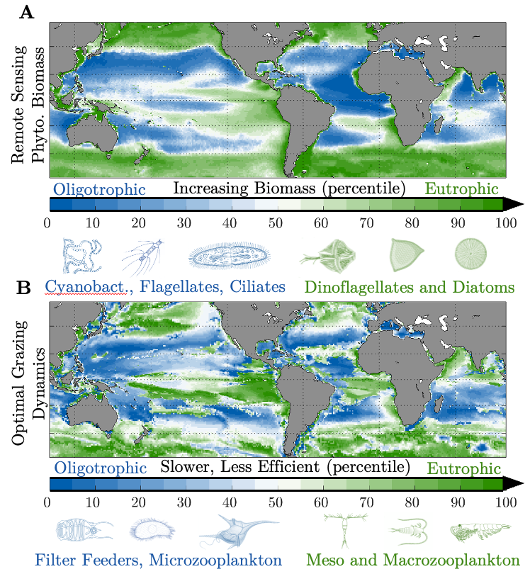
What’s the right grazing pressure?

Slide 16
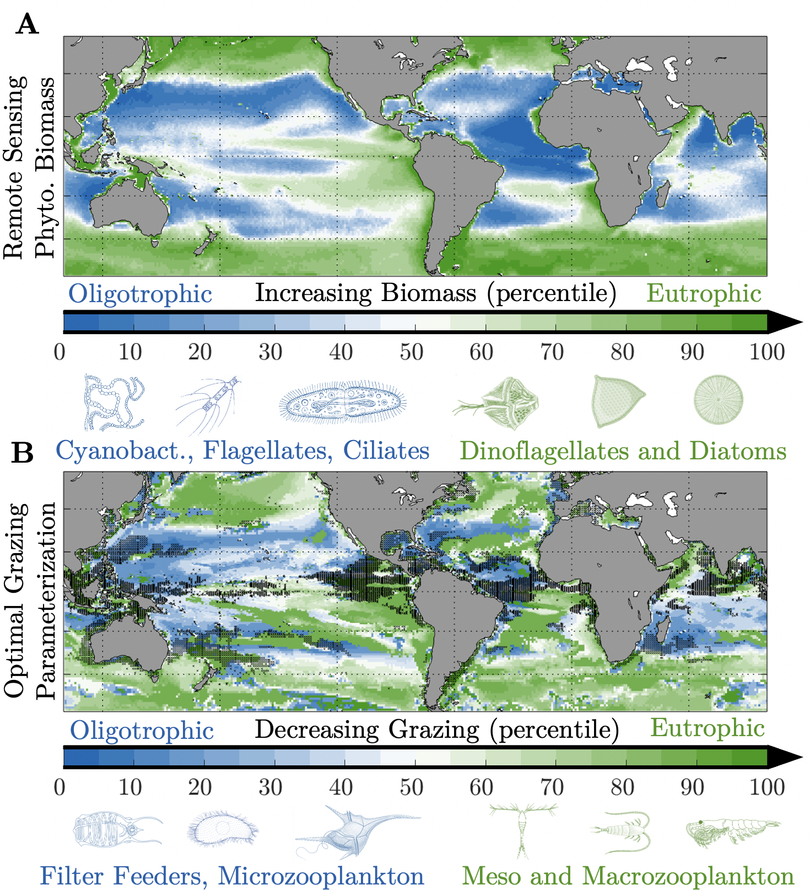
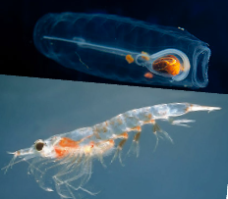
Responding to future change
Shallower MLDs
(More light, less nutrients)
More Cyclones
(More light, less nutrients)
More Anticyclones
(less light, more nutrients)
Deeper MLDS
(Less light, More nutrients)
Less Ice
(???)
Notes:
But if we can get it right (one way or another), and start to feel more confident about the way bgc models simulate grazing, I think it will open up a lot of really interesting avenues for investigation into how marine carbon cycling will respond to a changing climate.
So just as one hypothesis, we have all these competing physical processes with plenty of uncertainties, but lets say the ones that increase light and reduce nutrients (so shallower mixing, say) end up dominating in the SO

Slide 17
3. Analysis in Climate Pathways
Attributes
Faster Max Division
Lower Nutrient Requirements
Higher Light Requirements
Grazed Faster
Slower Max Division
Higher Nutrient Requirements
Lower Light Requirements
Grazed Slower
Notes:
This should lead to a shift toward small phytoplankton which have higher light requirements but lower nutrient requirements.

Slide 18
3. Analysis in Climate Pathways
Grazing
Attributes
Consume Smaller Phytoplankton
Graze Faster
Not Motile
Low Carbon Content
Consume Large
Phytoplankton
Graze Slower
Motile
High Carbon Content (Calcium Carbonate Shells)
Notes:
And in turn, that shift to small phytoplankton would likely be followed by a shift to salpes and other filter feeders and microzooplankton which graze faster but are only physically capable of grazing on those smaller phytoplankton.
Now in addition to preferring small phytoplankton and grazing faster, these zooplankton also typically cant swim and have lower carbon content than your canonical crustacean,
That means they are going to have totally different active and passive carbon export pathways that could be parameterized.
…
Which is all to say I'm quite curious how that all would play out in terms of the strength of the biological pump and ULTIMATELY the ocean's ability to buffer a changing climate.
So, This is where I think bgc models are so valuable, we can qualitatively all predict the direction of any given process, but to figure out how they all combine, and which ones win out, and what that means for our future, we really do need a computer to do the math.

Slide 19
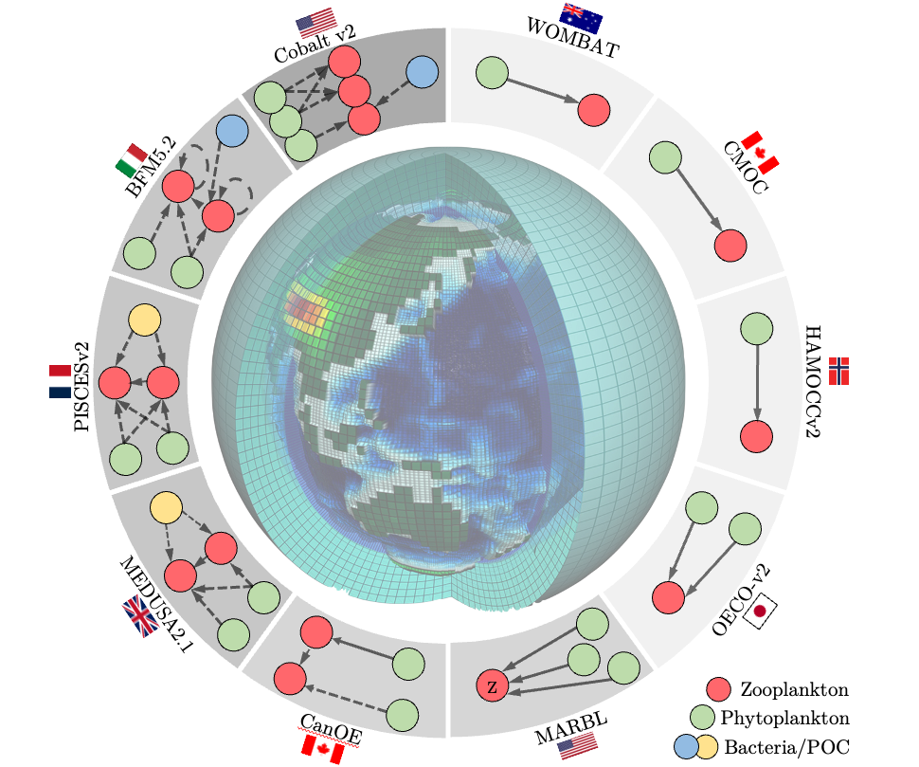
How do we get here?-Competition?

Slide 20
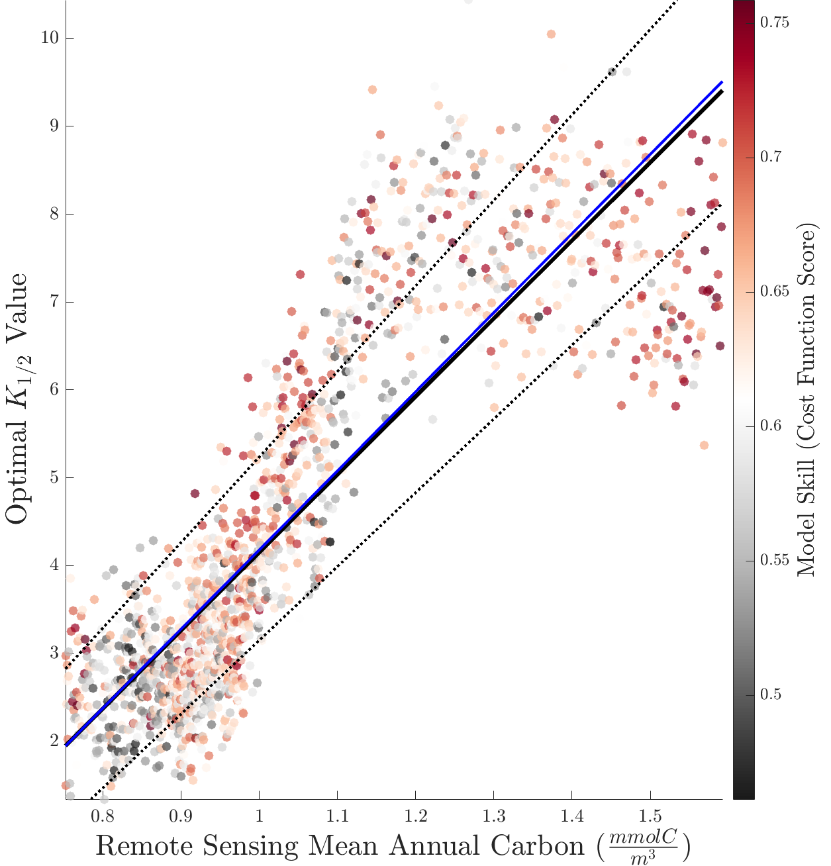
How do we get here?– Parameterization?

Slide 21
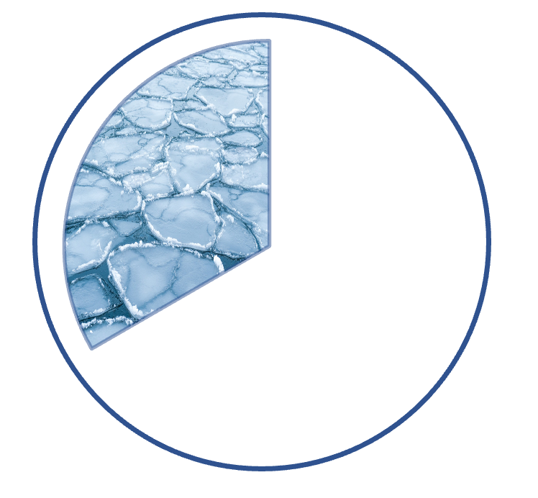
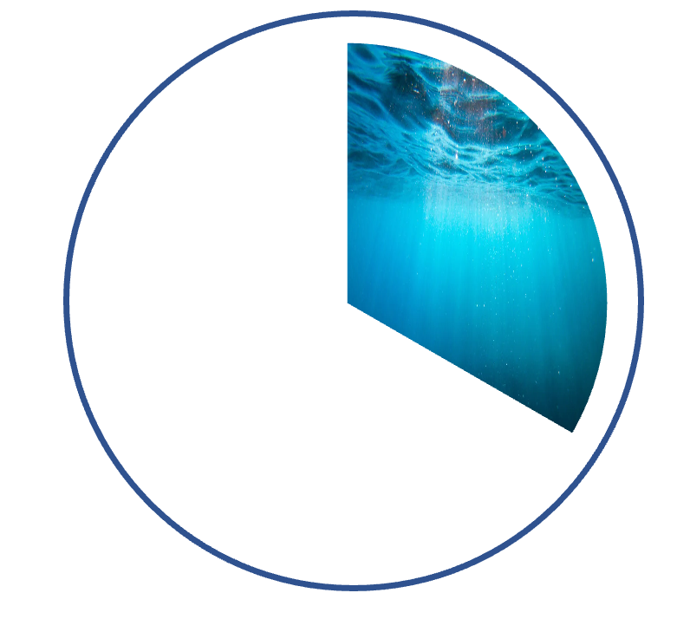


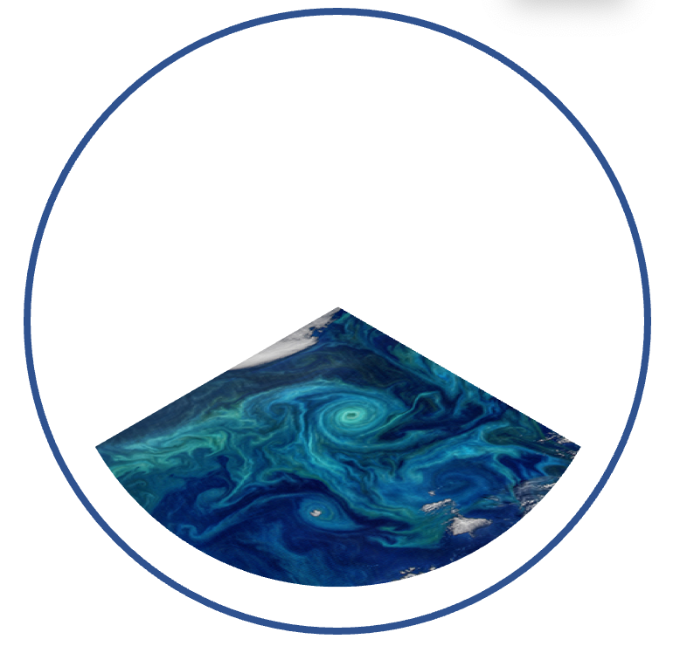
Thank You and Questions
Elizabeth Shadwick, Andrew Lenton, Anthony Richardson, Matthew Chamberlain
Notes:
And with that, I'm done!
A Big THANK YOU to the institutions, supervisors, and co-authors.
And now I'll open it up to questions.

