Slide 1
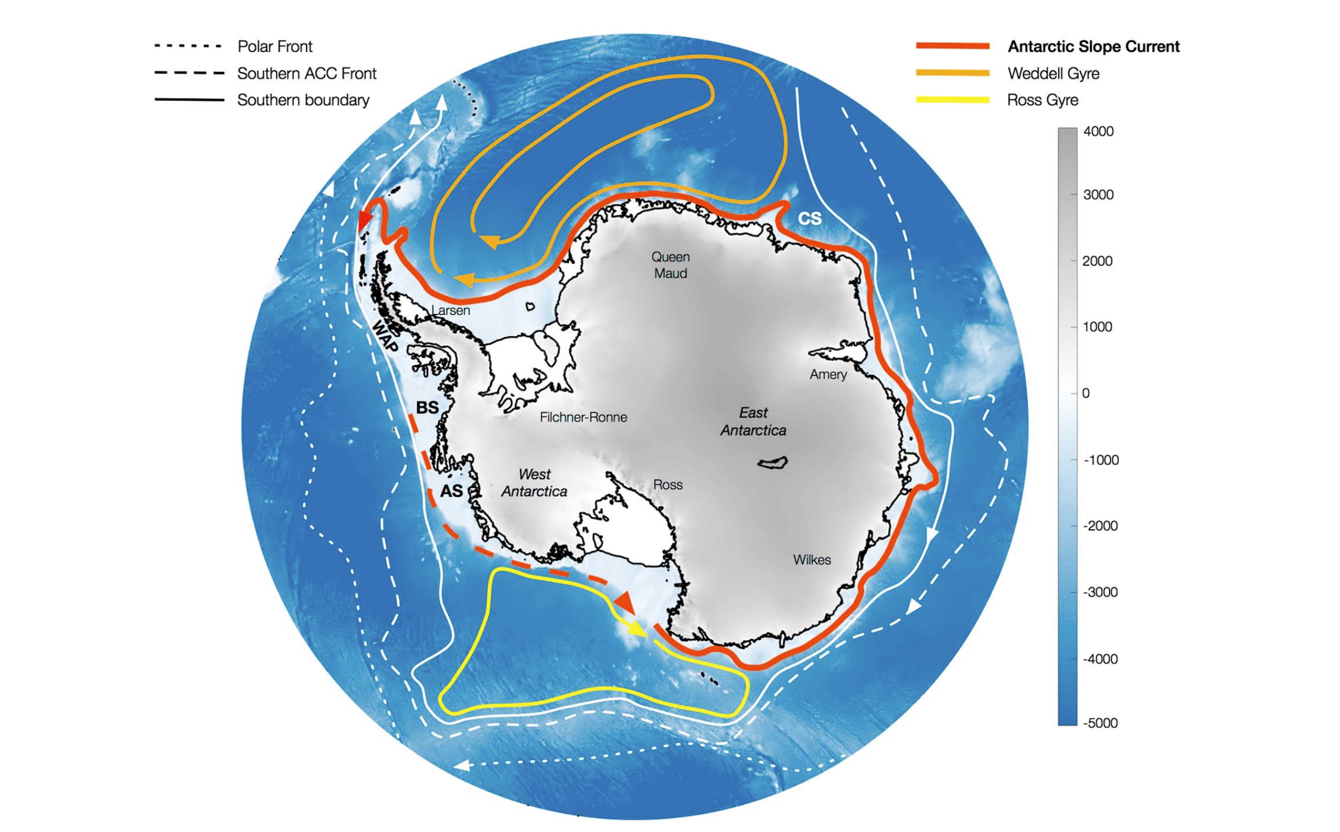
Episodic Intrusions of Circumpolar Deep Water via Canyons: An Idealised Study of the Antarctic Slope Current using MOM6
(Thompson et al. 2018)
Ellie Ong^{1,2}, Edward Doddridge³, Navid Constantinou⁴, Andrew Hogg³ , Matthew England^{1,2}
¹Climate Change Research Centre and ARC Centre of Excellence for Climate Extremes, University of New South Wales, ²ARC Centre for Excellence in Antarctic Science, University of New South Wales, ³Australian Antarctic Program Partnership, Institute for Marine and Antarctic Studies, University of Tasmania, ⁴Research School of Earth Sciences, and ARC Centre of Excellence for Climate Extremes, Australian National University
Notes:
*primarily a westward current that almost encircles the Antarctic continent
Acts as a barrier between the continent and the ACC/ Southern Ocean system
xSpatial variability in the ASC system, due to variations in wind and buoyancy forcing variations

Slide 2
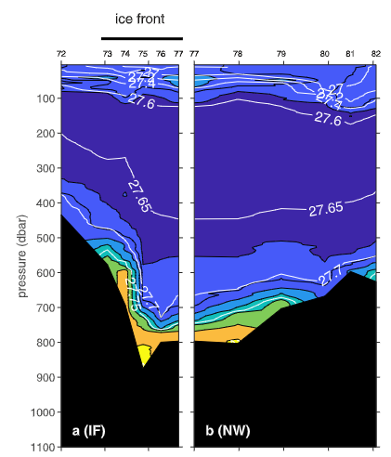
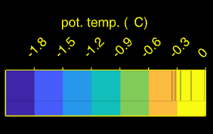
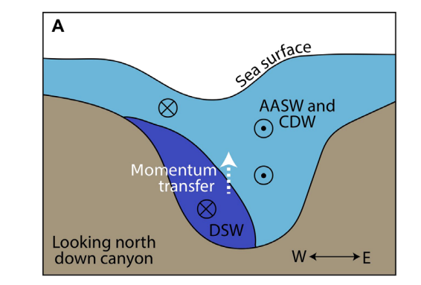
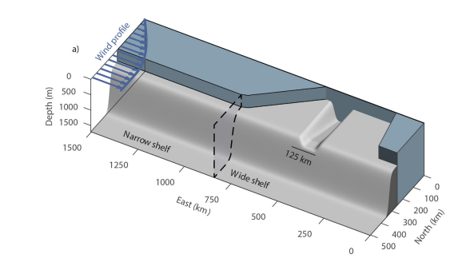
Easterly Wind
Motivation
Height
Ice Shelf
AASW
ASC
How is the cross-slope transport of warm water affected by canyons in East Antarctica?
Isopycnal
Observations (van Wijk et al. 2022)
East Antarctica
Continental Shelf
CDW
Offshore
👋🏼
Idealised Models
(Daae et al. 2017)
Schematic of CDW cross-slope transport in Ross Sea canyons (Morrison et al. 2020)
Canyons
Eddy resolving
Notes:
Remove fresh shelf diagram – can explain on the next slide

Slide 3
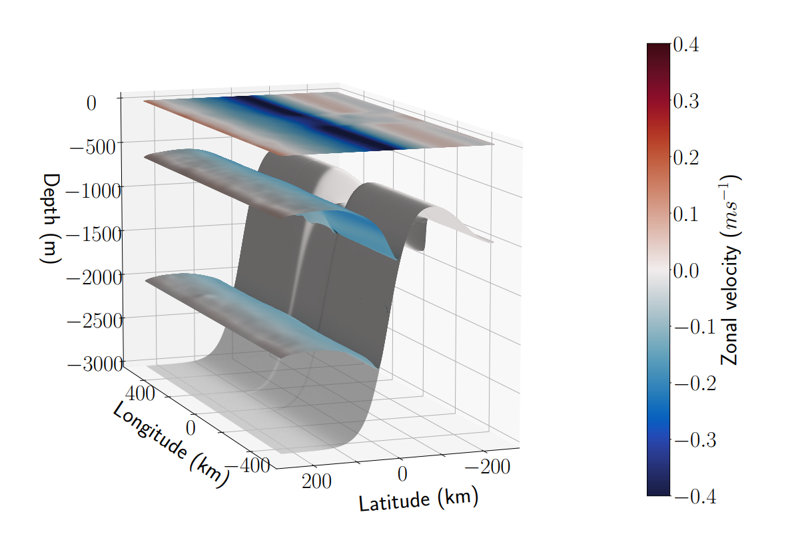
Model Setup + Reference Simulation
ASC
Channel configuration of Modular Ocean Model 6 of GFDL-NOAA
Isopycnal Model → divide water column into density layers
Allows for eddy-resolving experiments (1km lateral resolution)
Zonally symmetric + constant wind forcing
Antarctic Surface Water
Circumpolar Deep Water
Dense Shelf Water
E
N
S
W
Notes:
** LESS ACRONYMS

Slide 4
But - CDW transport is super episodic!
ASC
S
E
W
N
Speed in CDW layer on the continental shelf
Notes:
Butttt super episodic? – movies of speed
Wider canyons allow greater cross-slope transport of CDW that is more regular (not shown)
TO DO add highlight of CDW climbing onto the shelf

Slide 5
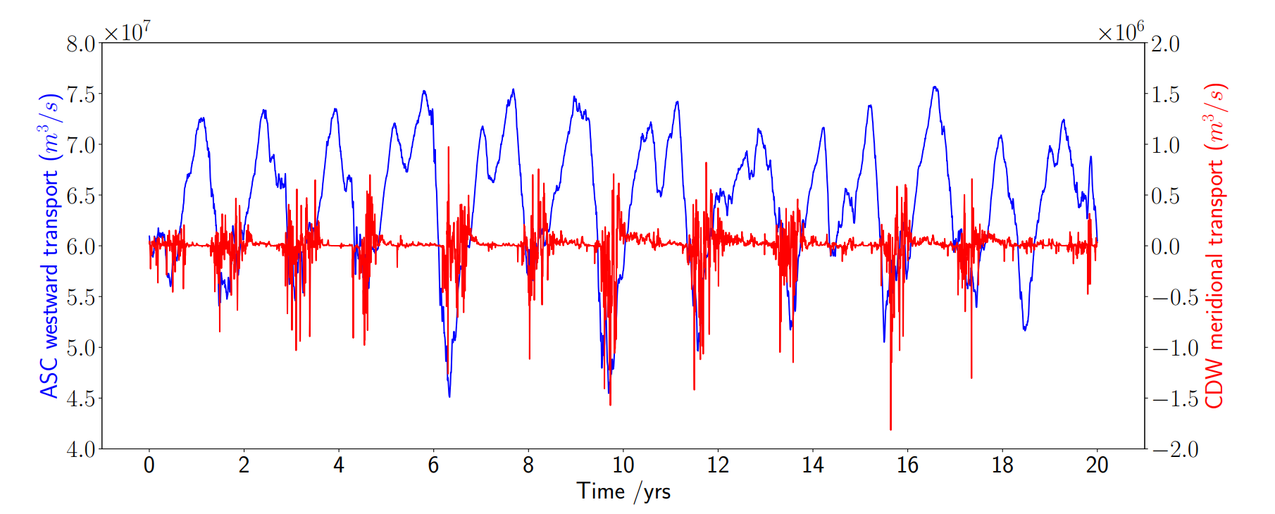
Intrinsic ASC variability
Episodic warm intrusion is linked to ASC strength
Consistent with obs, regional and circumpolar models (Nakayama et al. 2021, Huneke et al. 2021)
ASC is weaker when CDW intrusions occur
– cycle of ASC strength leads to the episodic intrusions
Notes:
Good (Y)

Slide 6
Why does the system not equilibrate to a constant ASC?
S
N
Do the wind forcing and generation of baroclinic instability not allow the system equilibrate?
Aim to understand the equilibrated state using a low-order model
Assumptions:
Two energy reservoirs: Total Eddy Energy and Available Potential Energy
Two-layer system
Rigid lid
ASC
$$h_{1}$$
$$η$$
$$h_{2}$$
$$L_{y}$$
Notes:
*clear laying out of system and rationale
Variability is due to energy exchanges between

Slide 7
Why does the system not equilibrate to a constant ASC?
S
N
Rigid lid
Low-order model of the ASC shows an oscillation in eddy energy (same as in MOM6)
ASC in East Antarctic is intrinsically oscillatory, which causes the episodic CDW intrusions through canyons!
ASC
$$h_{1}$$
$$η$$
$$h_{2}$$
$$L_{y}$$
Notes:
Emphasise that there is no other variability, constant wind forcing , WMT, it is an emergent property.

Slide 8
Summary
How is the cross-slope transport of warm water affected by canyons in East Antarctica?
Presence of a canyon allows for intrinsically episodic intrusions of CDW
Low-order model shows that ASC has oscillatory behaviour
Intrinsically oscillatory ASC in East Antarctica governs variability of CDW intrusions via canyons
Next steps
Understand mechanisms driving this oscillatory ASC
ASC
S
N
Speed in CDW layer on the continental shelf
Thank you! Contact: ellie.ong@unsw.edu.au

Slide 9
References
Daae, K., Hattermann, T., Darelius, E., and Fer, I. (2017). On the effect of topography and wind on warm water inflow—An idealized study of the southern Weddell Sea continental shelf system. Journal of Geophysical Research: Oceans, 122(3):2622–2641
Hallberg, R. (2013). Using a resolution function to regulate parameterizations of oceanic mesoscale eddy effects. Ocean Modelling, 72:92–103
Herraiz-Borreguero, L., Church, J. A., Allison, I., Peña-Molino, B., Coleman, R., Tomczak, M., and Craven, M. (2016). Basal melt, seasonal water mass transformation, ocean current variability, and deep convection processes along the Amery Ice Shelf calving front, East Antarctica. Journal of Geophysical Research: Oceans, 121(7):4946–4965.
Huneke, W. G., Morrison, A. K., and Hogg, A. M. (2022). Spatial and Subannual Variability of the Antarctic Slope Current in an Eddying Ocean–Sea Ice Model. Journal of Physical Oceanography, 52(3):347–361
Morrison, A. K., Hogg, A. M., England, M. H., and Spence, P. (2020). Warm Circumpolar Deep Water transport toward Antarctica driven by local dense water export in canyons. Science Advances, 6(18).
Thompson, A. F., Stewart, A. L., Spence, P., and Heywood, K. J. (2018). The Antarctic Slope Current in a Changing Climate. Reviews of Geophysics, 56(4):741–770.

Slide 10
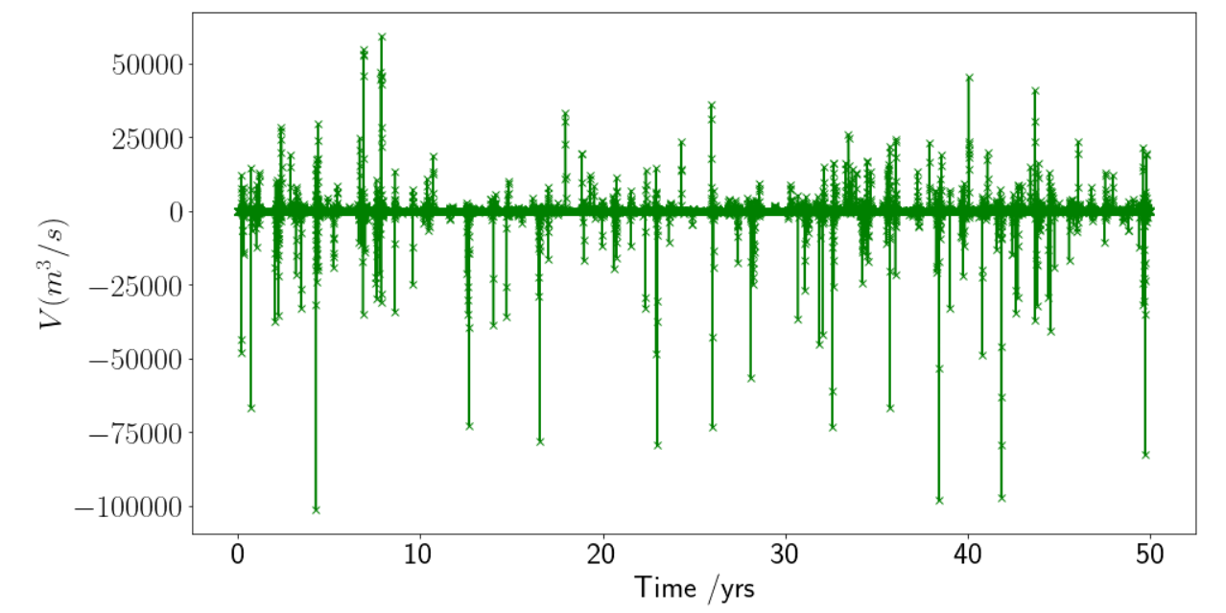
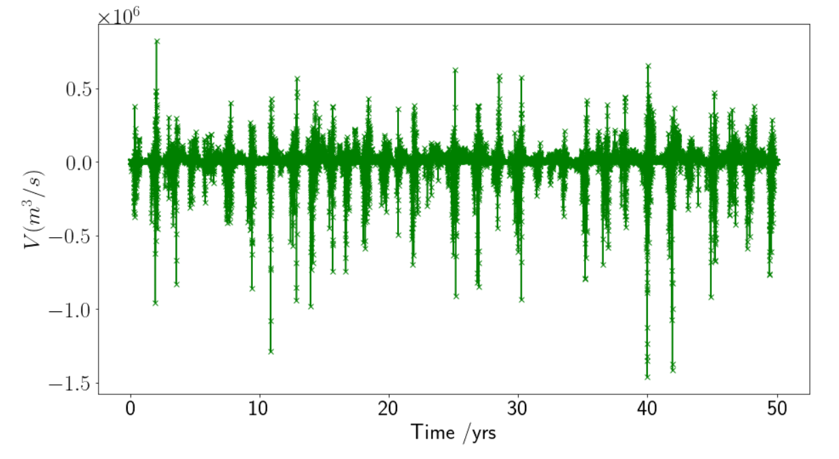
Time series of meridional transport ($V$) in CDW layer
Canyon width 20km
Canyon width 200km
Offshore CDW transport
Onshore CDW transport
Gradual transition to onshore CDW transport
Onshore CDW pulses

Slide 11
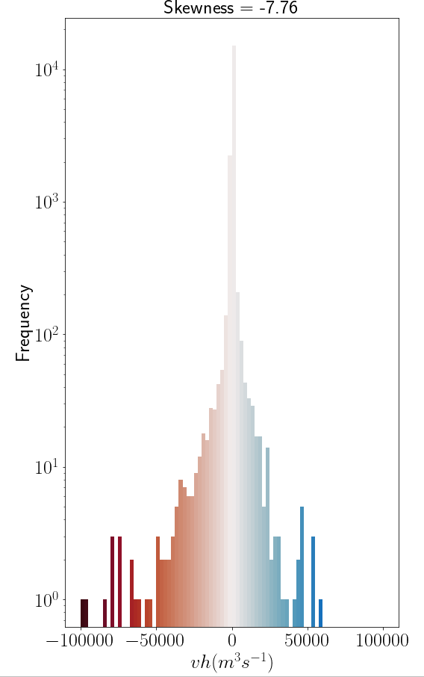
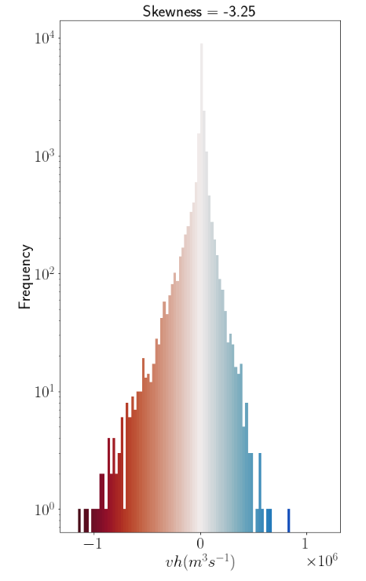
Probability density function of meridional transport $(V)$
Canyon width 20km
Canyon width 200km
Skewness = -7.76
Skewness = -3.25
Narrow canyon case is more negatively skewed
Narrow canyons have a greater asymmetry in CDW flows
Onshore CDW transport
Offshore CDW transport
$$V$$
$$V$$

Slide 12
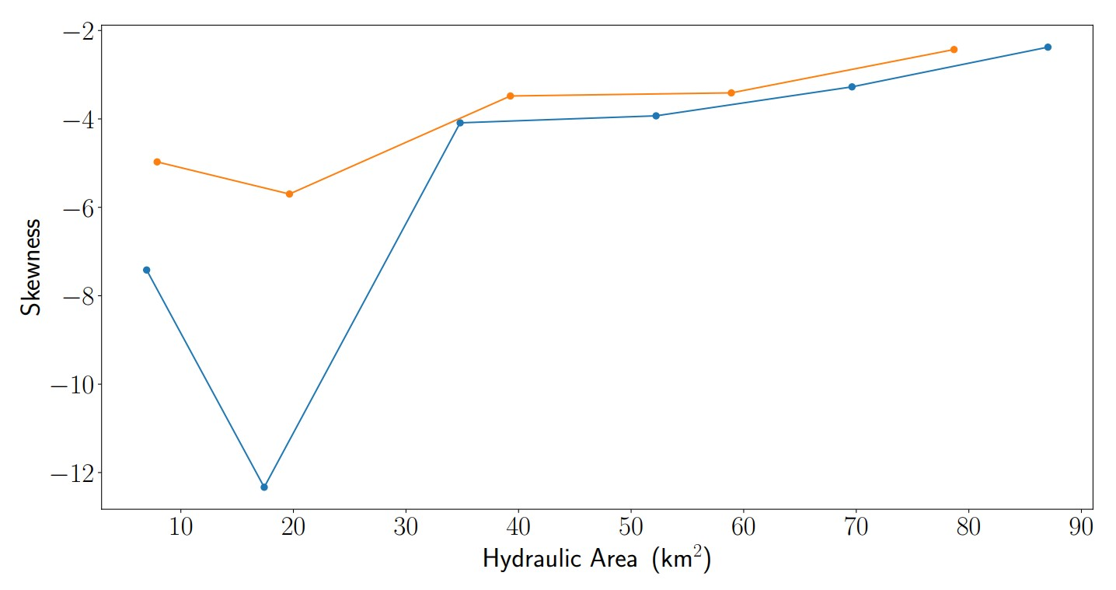
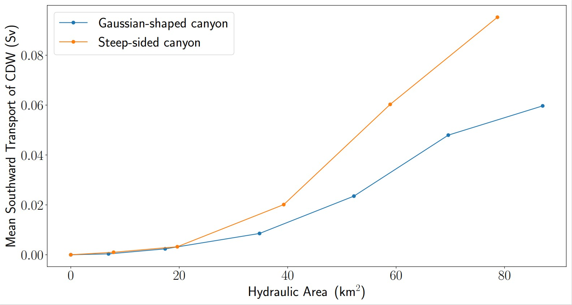
Skewness of meridional transport ($V$) with canyon hydraulic area
Increasing asymmetry of onshore CDW flow
Narrow canyons allow for more asymmetrical onshore flows + play a smaller role in cross-slope transport of CDW.
Increased onshore transport of CDW

Slide 13
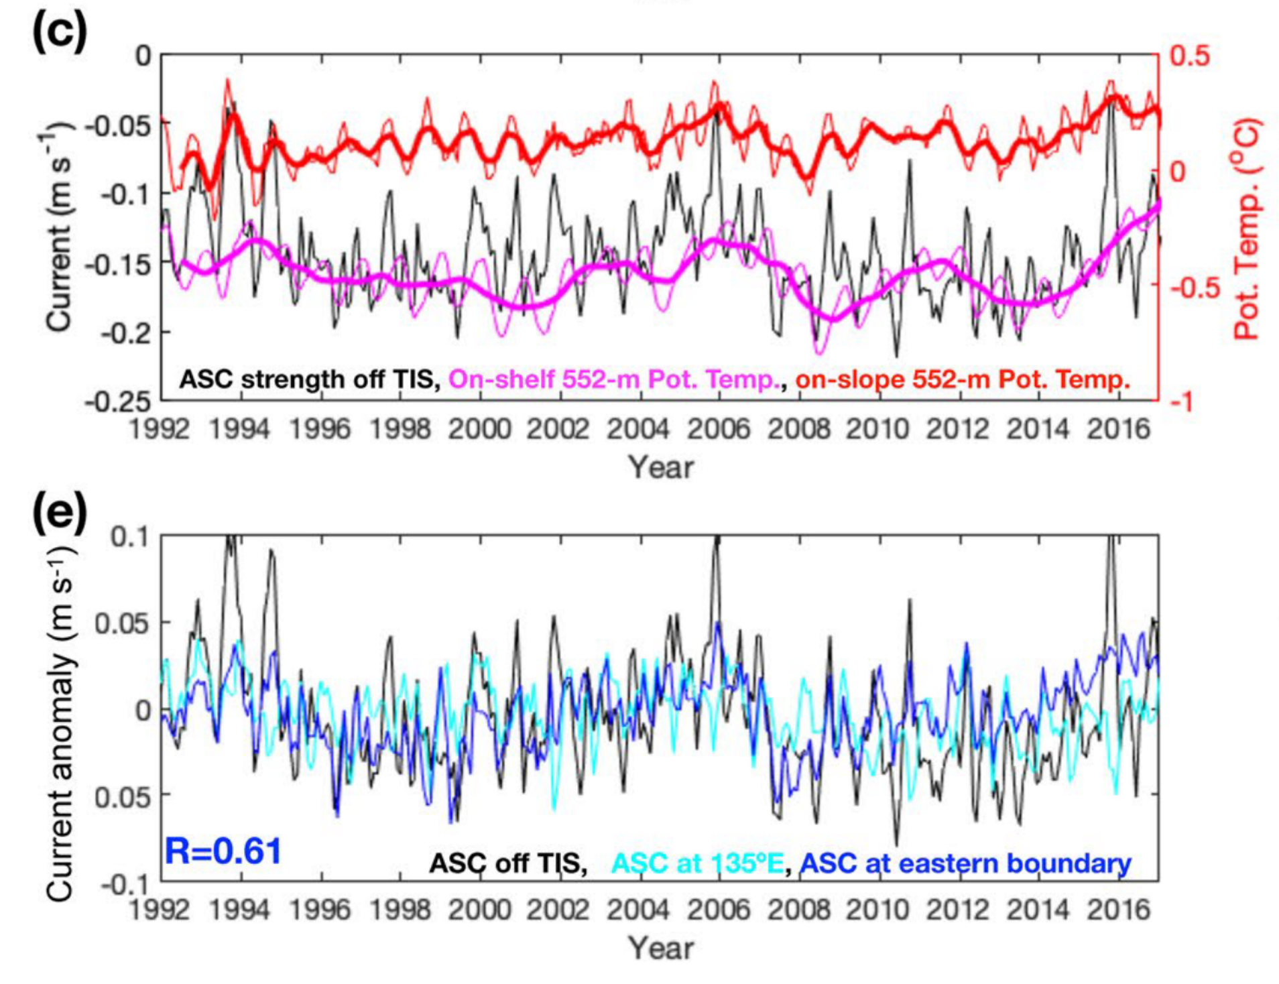
Nakayama et al. (2021)
Regional model shows ASC variability at similar timescale to MOM6 and low-order model
Attribute variability to boundary conditions
Notes:
xmitgcm library for results_zenodo
Open meta file to look at coordinates and variables

Slide 14
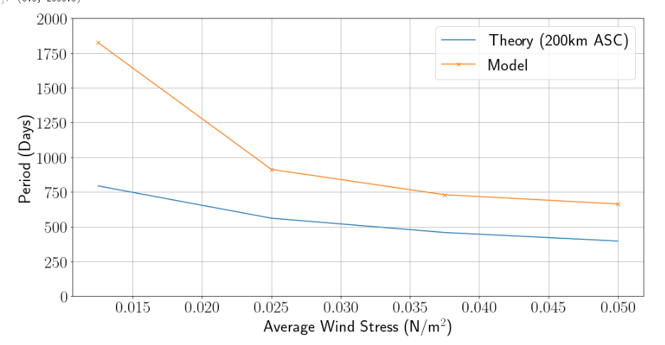
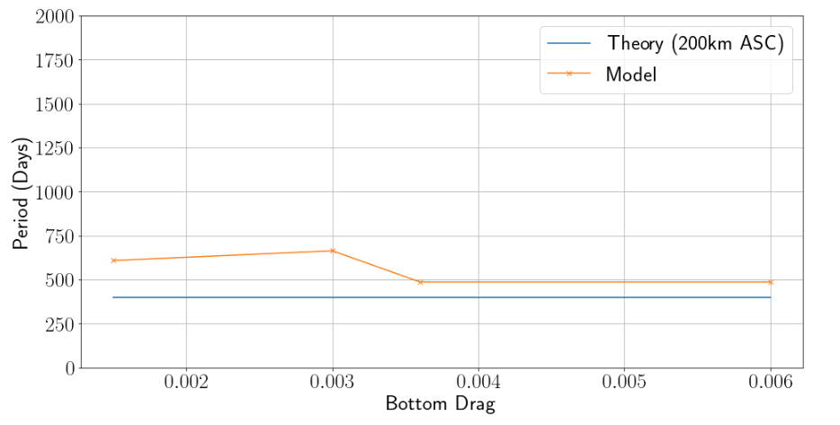
Period of oscillatory solution
→ Frequency increases with wind and is independent of drag
- Conduct experiments varying wind and bottom drag
Period of oscillatory solution decreases with wind stress
Period of oscillatory solution is independent of bottom drag
Oscillatory solution from theory matches trends in experiments
ASC in MOM6 experiments is intrinsically oscillatory – implications on CDW intrusions!
Notes:
Conclude that the ASC is inherently oscillatory in the low –order model and mom6, by consequence of energy exchanges.
ASC in East Antarctica can have its own intrinsic variability, and in a dynamical regime where the main barrier to warm water climbing on to the continental shelf is this slope current, understanding this internal variability would be critical to observing and predicting these warm water intrusions accurately

Slide 15
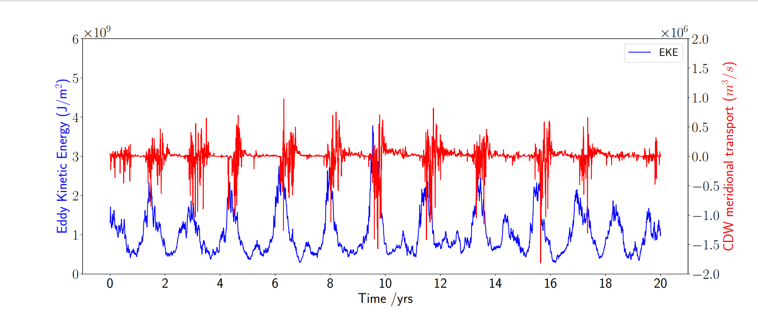
Low-Order Model of ASC
→ Find equilibrated state and linearise equations to get
$$\frac{dE}{dt}=eddy energy conversion −linear damping$$
$$\frac{dAPE}{dt}=wind input−eddy energy conversion$$
→ Solution is oscillatory, eddy energy in ASC will always vary in time!
Oscillatory solution from low-order model matches trends in experiments
ASC in East Antarctica is intrinsically oscillatory, which causes the episodic CDW intrusions through canyons!

