Slide 1
Future projection simulations using COSIMA ocean-ice models

Slide 2
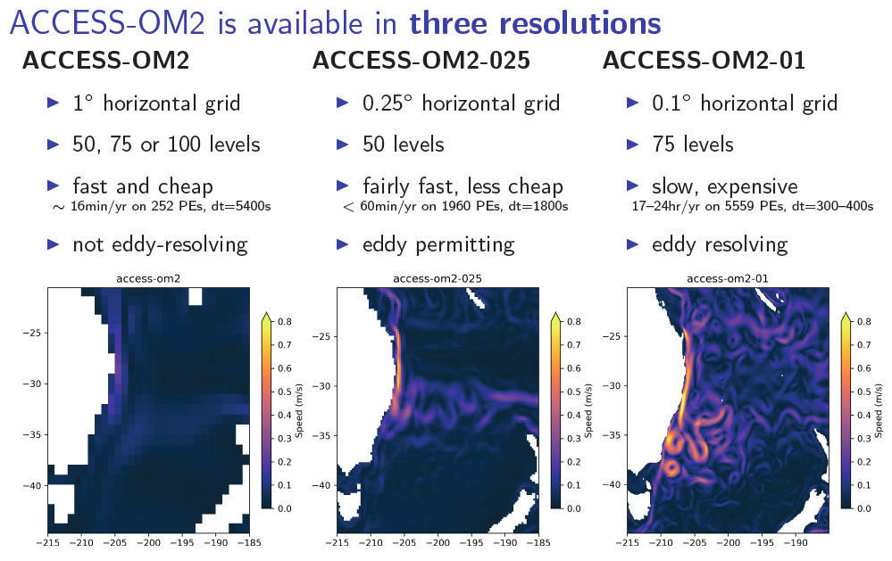
Future projection simulations using COSIMA ocean-ice models

Slide 3
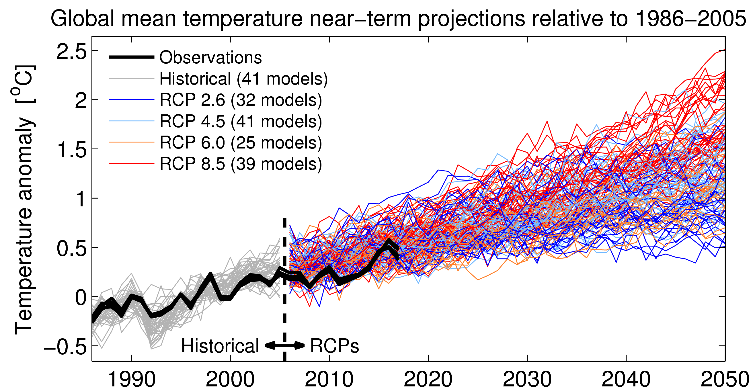
Future projection simulations using COSIMA ocean-ice models

Slide 4
Future projection simulations using COSIMA ocean-ice models
JRA55 CORE IAF

Slide 5
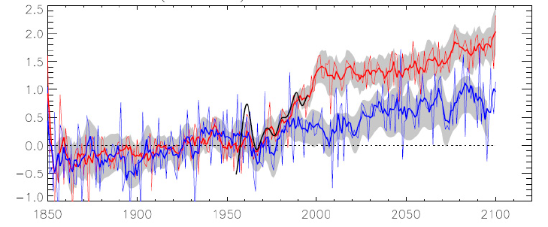
Future projection simulations using COSIMA ocean-ice models
Spence et al. 2014

Slide 6
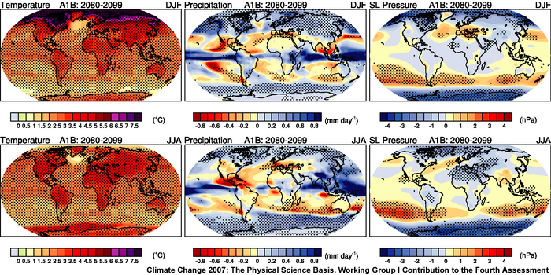
Future projection simulations using COSIMA ocean-ice models

Slide 7
Future projection simulations using COSIMA ocean-ice models
Spence et al. 2014

Slide 8
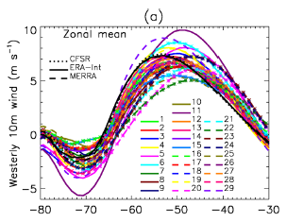
Future projection simulations using COSIMA ocean-ice models
Spence et al. 2014

Slide 9
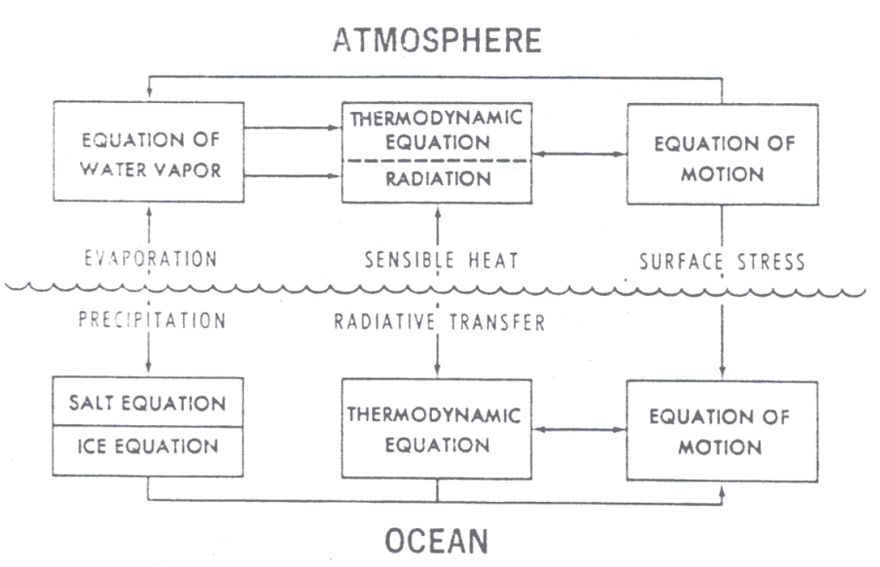

Slide 10
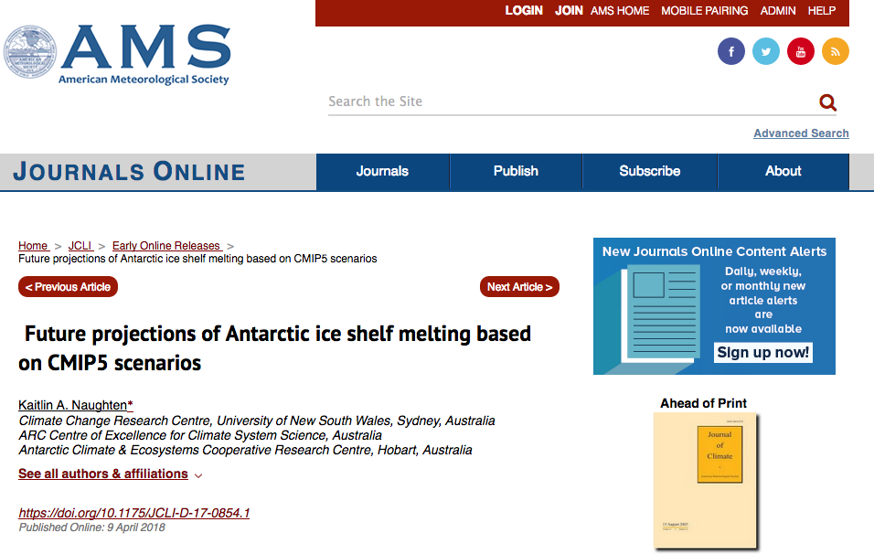

Slide 11
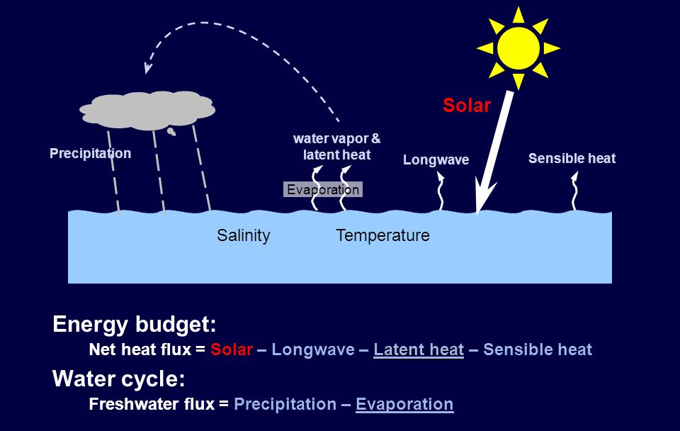
Future projection simulations using COSIMA ocean-ice models

Slide 12


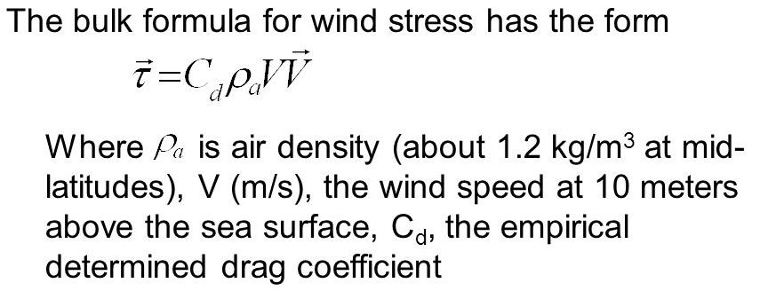
Air-sea heat fluxes
Q_{lw} ~ SST⁴
Wind stress
Air-sea FW fluxes
Net FW flux = P + R – E
+ G + B

Slide 13
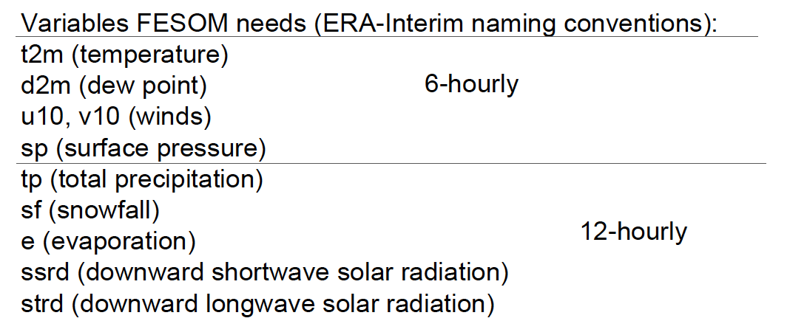

Slide 14
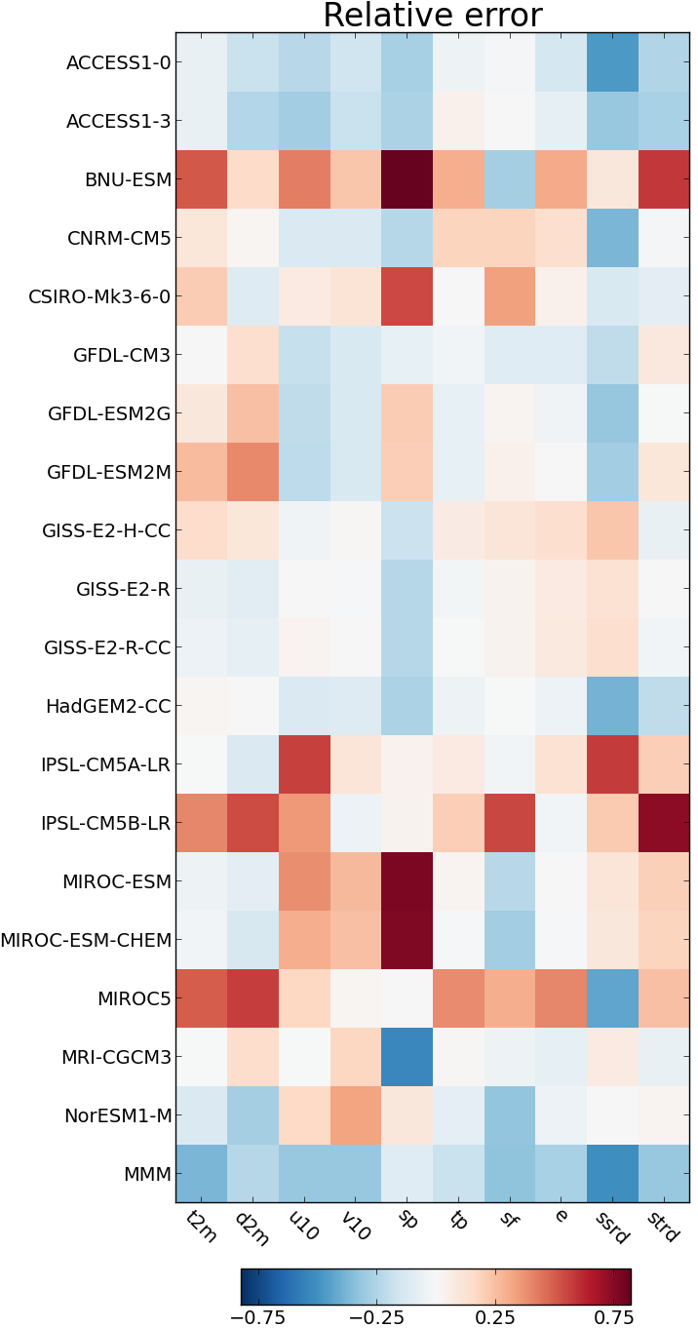
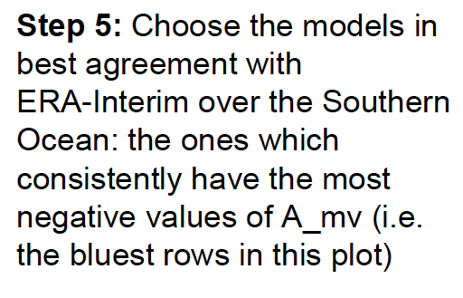
Naughten et al. 2018

Slide 15
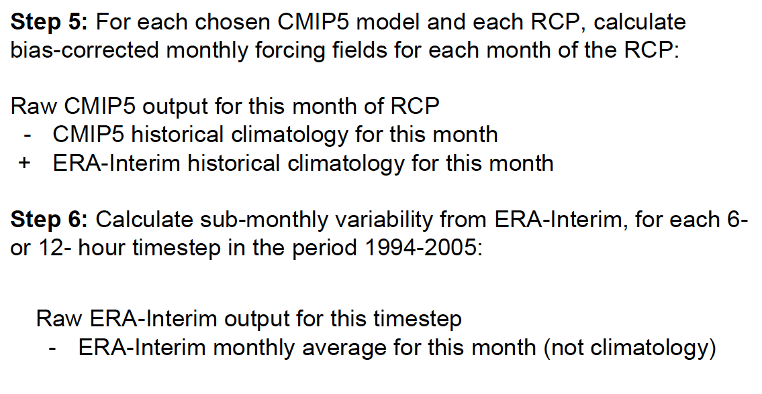
Future projection simulations using COSIMA ocean-ice models

Slide 16
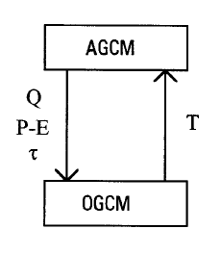
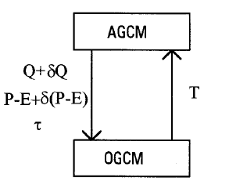
Not unlike flux-adjusted coupled models…
+ δτ

Slide 17
CMIP5 ‘climatological’
T_{A}, U, V, Q_{sw} …
CMIP5 projected
T_{A}, U, V, Q_{sw} …
OBSERVED T_{A},
U, V, Q_{sw} …
OBSERVED T_{A},
U, V, Q_{sw} …
+ δτ

Slide 18
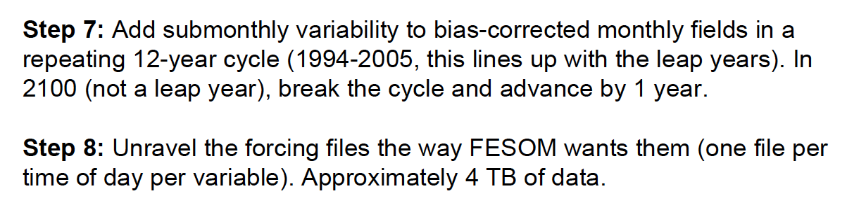

Slide 19
Future projection simulations using COSIMA ocean-ice models

Slide 20
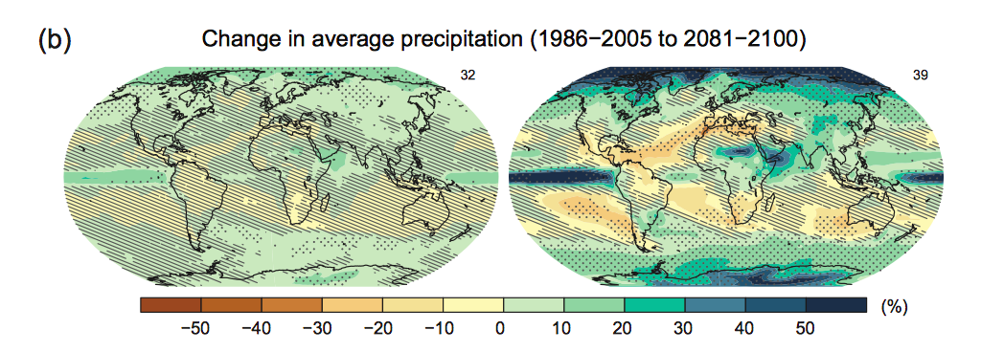
Future projection simulations using COSIMA ocean-ice models

Slide 21
Future projection simulations using COSIMA ocean-ice models
Applications
    Future ocean circulation, AMOC, AABW etc.
    Future projections of EKE change, ACC dynamics
    Ocean heat uptake? Distribution, rate etc.
    High-res projections of sea-ice changes
    Coastal circulation and hydrographic change
    Coupled carbon?

Slide 22
Future projection simulations using COSIMA ocean-ice models
Problems / issues:
  Net T_{A} warming already prescribed
  CMIP5 // JRA55 biases can be strong
  Separation of wind, heat & FW components?
  Transient vs. Snapshot approach?
  Missing melt-water
  Expensive at 0.1 degree resolution

Slide 23
Future projection simulations using COSIMA ocean-ice models
Jan spoke about a poor-person’s version of this – step change.
Kaitlin’s approach (akin to flux-adjusted experiments!)
Uses?
    Future projections of EKE change
    Future circulation fields, AMOC etc.
    Ocean heat uptake? Distribution, rate etc.
    Projections of sea-ice changes?
    Other: Andy shout out.

